Slide 2
KWL- What I Know, What I think I know, What I don’t know!

Slide 3
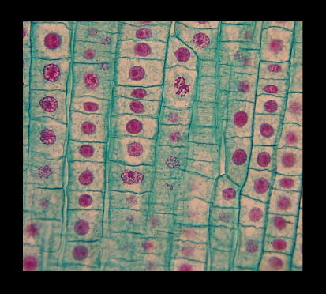
Cells - The Basic Units of Life
Characteristics of Life and Organelles
Organelles: 4.1.1 illustrate and explain that the cell is a living system that exhibits the following characteristics of life (304-4)

Slide 4
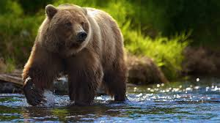
Am I Alive?

Slide 5
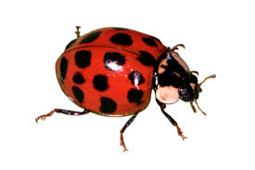
Am I Alive?

Slide 6
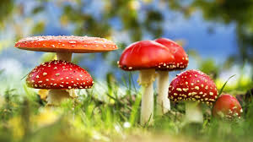
Am I Alive?

Slide 7
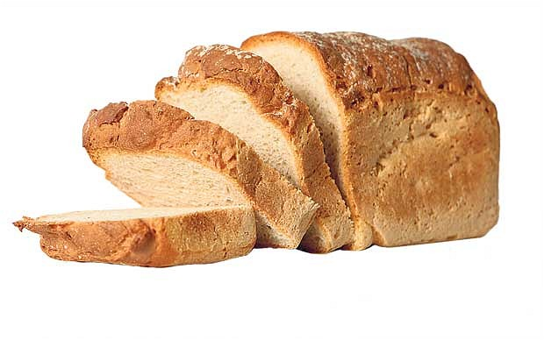
Am I Alive?

Slide 8
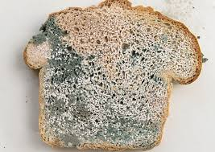
Am I Alive?

Slide 9
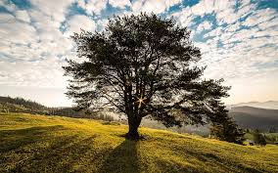
Am I Alive?

Slide 10
Am I Alive?

Slide 11
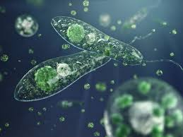
Am I Alive?

Slide 12
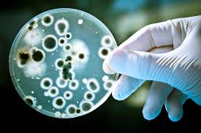
Am I Alive?

Slide 13
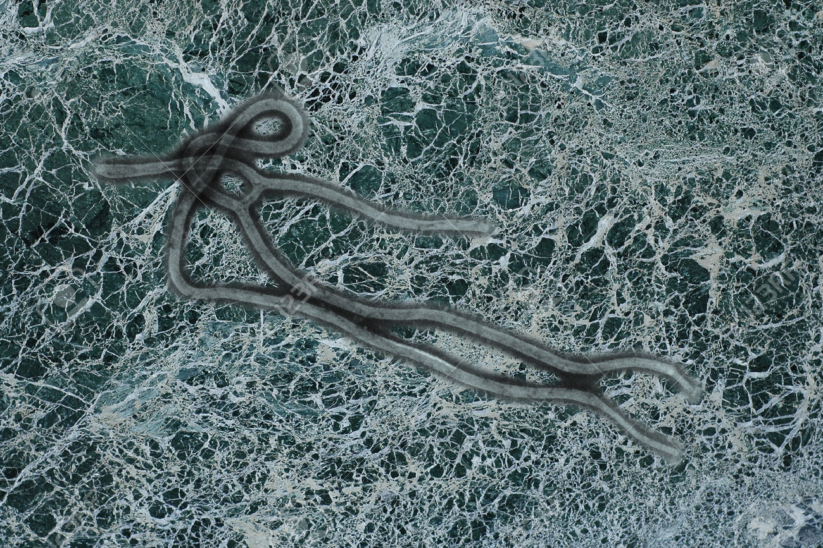
Am I Alive?

Slide 14
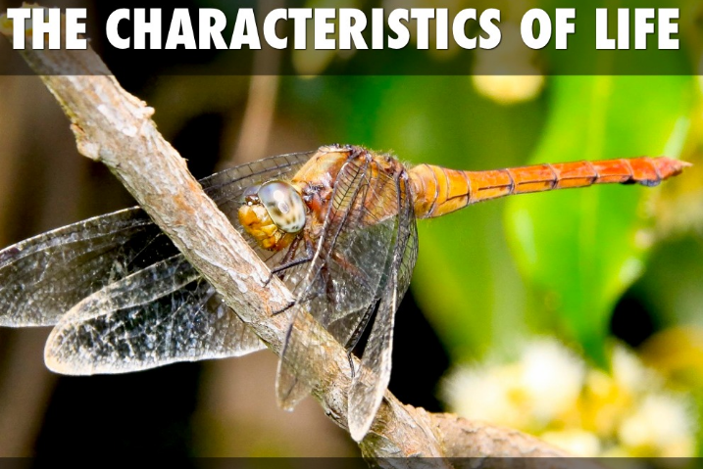
What are the characteristics of life?

Slide 17
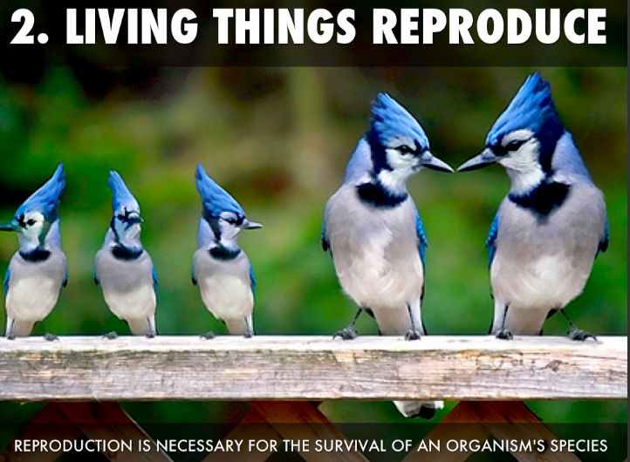

Slide 22
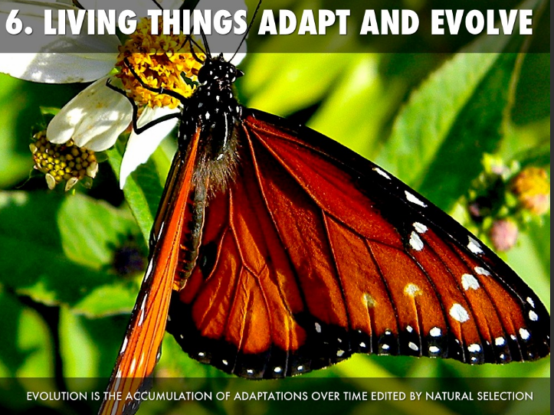

Slide 23
How do we know something is living or non-living?
Living | Non Living
Please sort the items as living or non­living.
Algea Zombie
Shell Hair
Fire Siri
Wind Bacteria Water Virus
Crystal Sun
Car Oak Tree
Rose Bush Human
Elephant Jellyfish
Coral Fallen Leaf
Seed Atoms
Fungus Molecules

