Slide 2
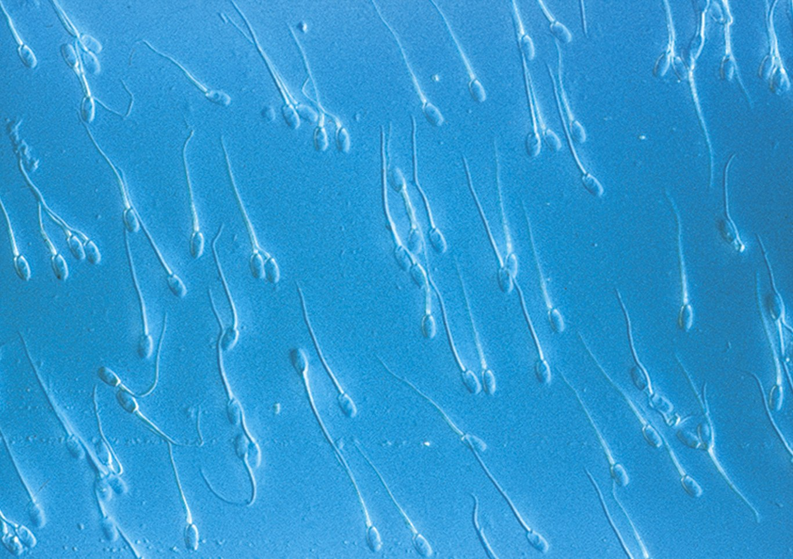
Cell Structure and Function

Slide 3
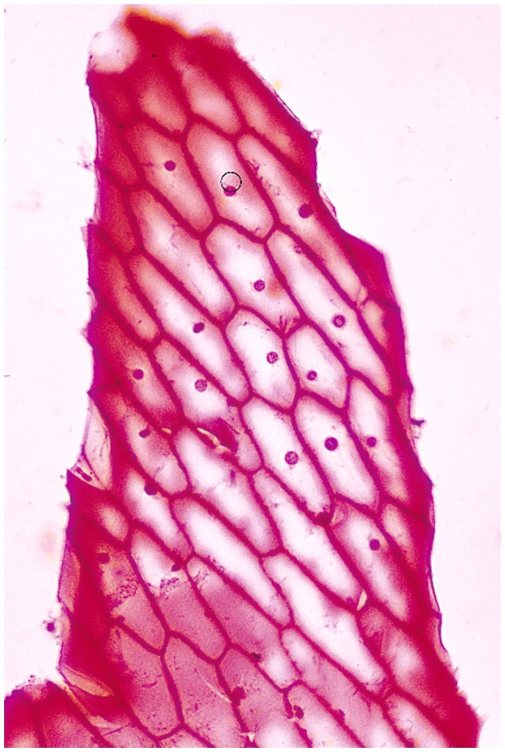
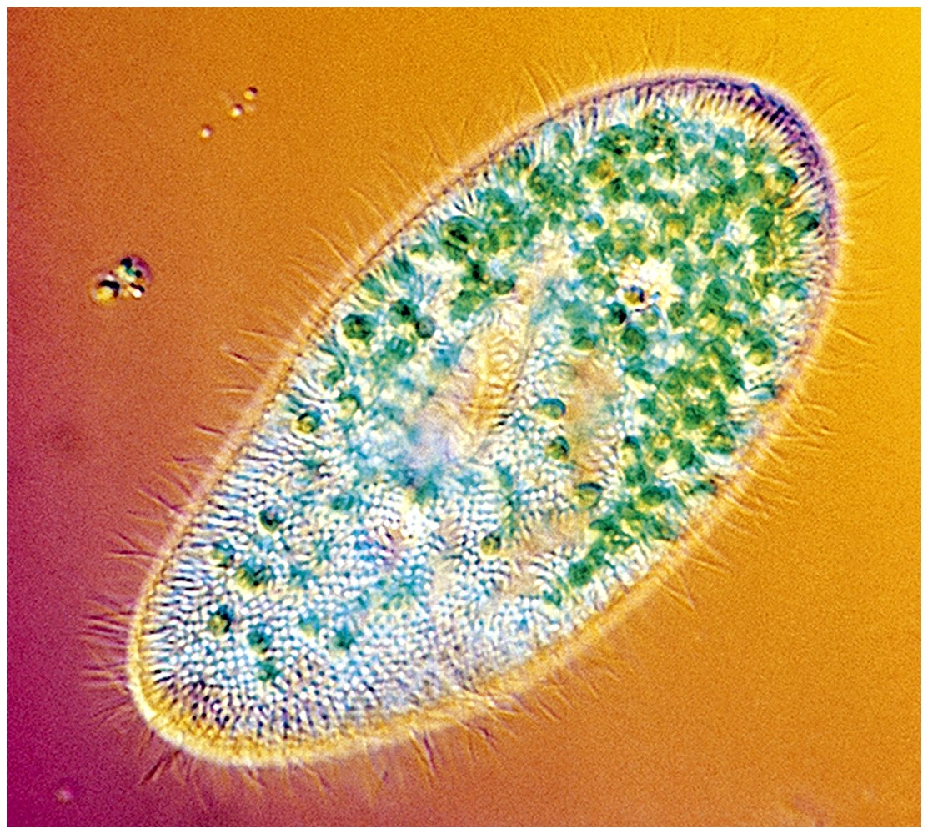
Cells
Smallest living unit
Most are microscopic

Slide 4
Principles of Cell Theory
All living things are made of cells
Smallest living unit of structure and function of all organisms is the cell
All cells arise from preexisting cells
(this principle discarded the idea of
spontaneous generation)

Slide 5
The Wacky History of Cell Theory
The wacky history of cell theory
http://ed.ted.com/lessons/the-wacky-history-of-cell-theory

Slide 6
Timeline
Scientist | Year | Discovery
Hooke | 1674 | Observed that a slice of cork looked like it was made up of small chambers under the microscope. He called these empty chambers “Cells”
Leeuwenhoek | 1666 | First to view living organisms under a microscope. Called them “animalcules”
Schleiden | 1838 | Discovered that plants are made of cells
Schwann | 1839 | Discovered that animals are made of cells
Virchow | 1855 | Discovered that cells came from existing cells.

Slide 7
The Cell Theory:
All living organisms are composed of one or more cells.
Cells are the basic units of structure and function in all organisms.
All cells come from previously existing cells.
**The activity of an entire organism depends on the total activity of its independent cells.**

Slide 8
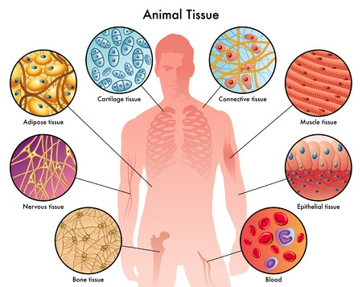
All living things are composed of cells which are shaped to fit their functions.

Slide 9
Kahoot Time! ☺

