Slide 1
Science 8- Microscope Lab
Post Lab Wrap Up

Slide 2
Reminders
There will be a quiz on Living Characteristics & Parts of the Cell on:
Wednesday October 17th (803) or Friday October 19th (802)
Review Sheet will be provided and Found Online (msdcarter.weebly.com)
ALL PERMISSION FORMS and MONEY ($$) for Discovery Centre field Trip are due by FRIDAY OCTOBER 19th!
Discovery Centre Field Trip on Monday October 22nd (9:15am-1:45pm); BRING YOUR OWN LUNCH!

Slide 3
Outcomes Achieved in Lab Activity
I can use a light microscope to see cells.
I know the difference between plant and animal cells
I understand that a cell is alive because it can grow, move, respond and reproduce.

Slide 4
Plant Cells- Onion
Many students had luck finding something similar to this (except Yellow/Brown color) at 100X

Slide 5
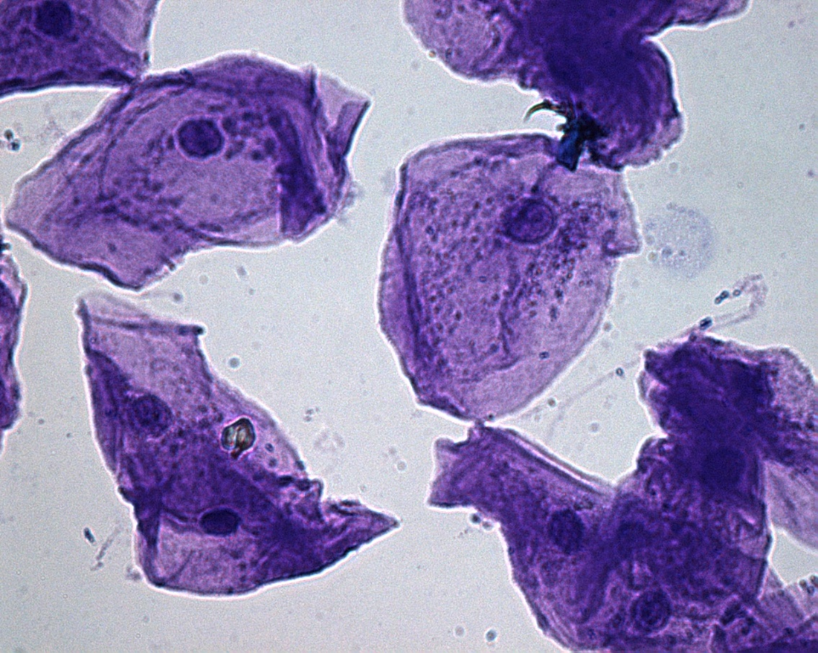
Animal Cell- Cheek Cells
Difficult to see, not many had any luck; should have looked like this at 400X (except brown, yellow due to iodine)

Slide 6
Comparing Plant and Animal Cells
Plant (Onion)
Animal (Cheek)
Nucleus
Cell Wall
Chloroplast
Cytoplasm
Cell Membrane
Plant Only | Similarities | Animal Only

Slide 7
What didn’t we see?
https://www.youtube.com/watch?v=URUJD5NEXC8

Slide 8
What are we doing now?
Finish lab sheet
Work on Organelle analogy sheet
Study for quiz

Slide 9
Bill Nye- Cells
https://vimeo.com/116866613

