Slide 1
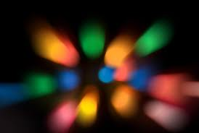
LIGHT
Reflection Continued

Slide 2
What we know so far…
What is light?
Energy our eyes can see
What are the 2 sources of light?
Natural and artificial
What are objects called that give off their own light?
Luminous
What are all other objects called?
Nonluminous
How do we see the things around us that are not producing their own light?
Reflection
The amount of energy a surface receives depends on the ???????? of the light.
Intensity

Slide 3
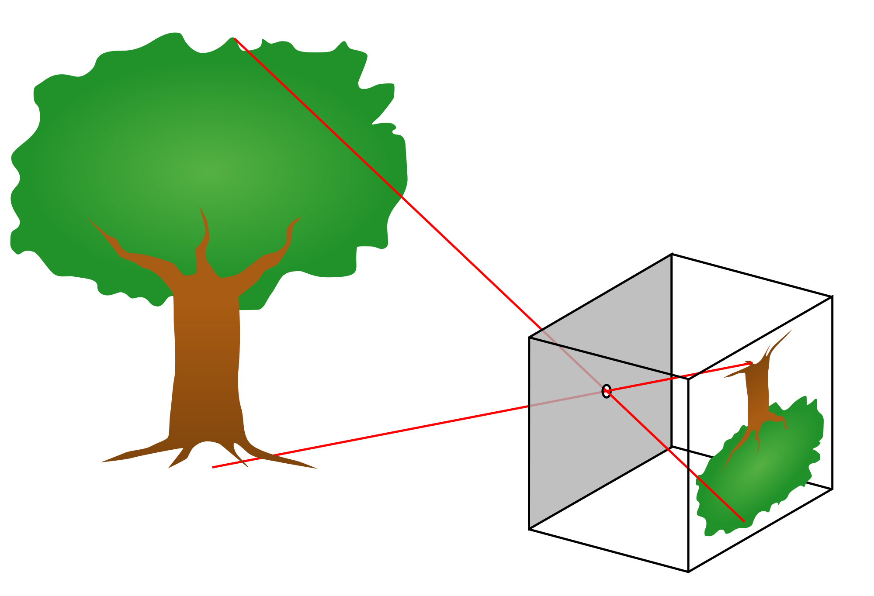
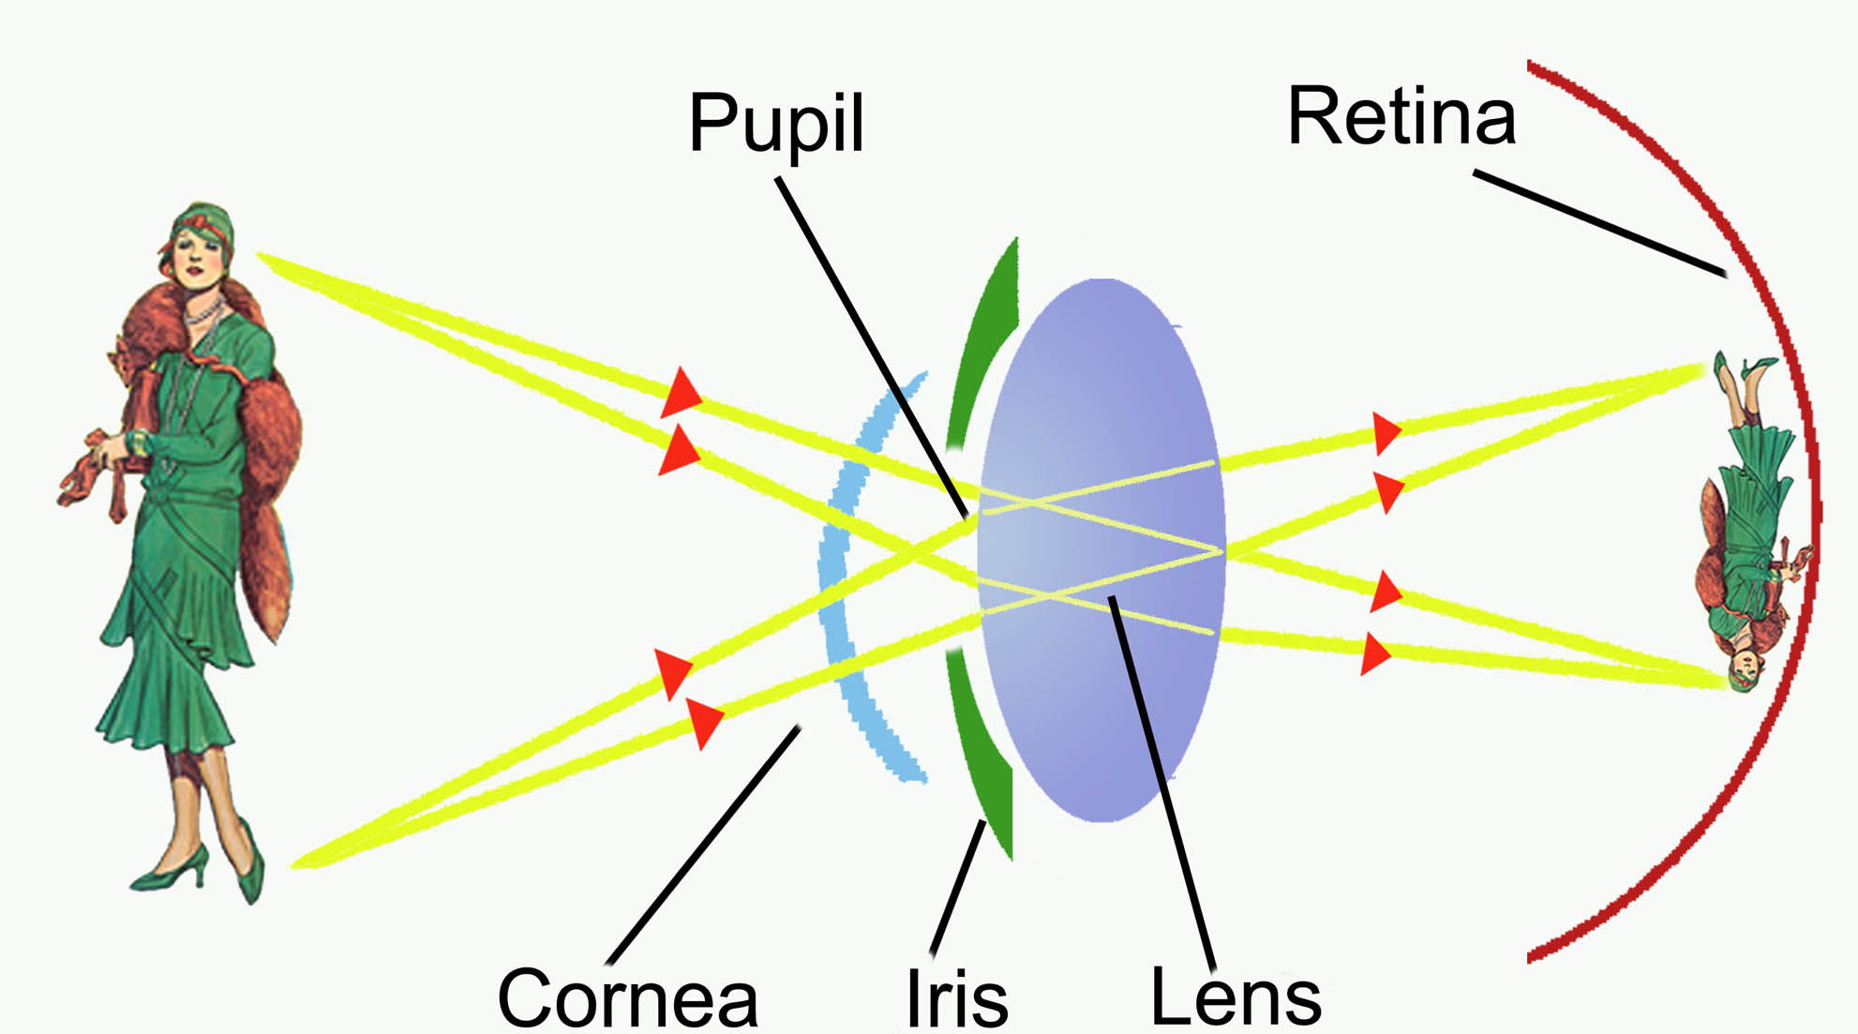
Light always travels in _________________
A straight line
Until….
It hits something and passes through, is reflected, scattered or absorbed
Transparent, Translucent and Opaque
how light travels in a straight line (and produces an inverted – upside down – image. Works similar to our eyes.
The angle of ???????? always equals the angle of ???????

Slide 4
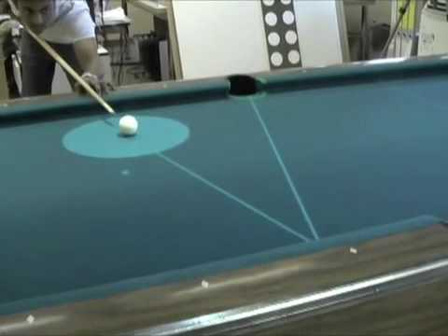
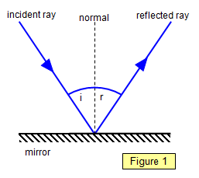
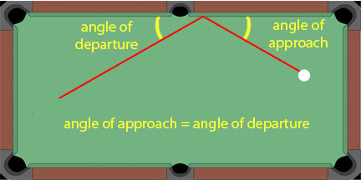

Slide 5
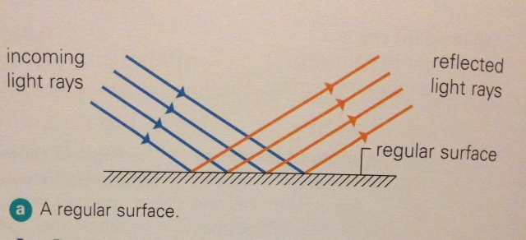
Regular Reflection
The reflection of light off a smooth, shiny surface is called regular reflection.
When light reflects in this way we can see an image (this happens off mirrors and shiny surfaces).

Slide 6
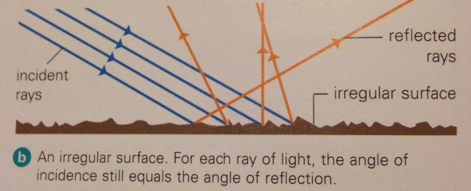
Diffuse reflection
But most surfaces are not regular.
The reflection of light off an irregular surface is called diffuse reflection.
Irregular surfaces scatter the reflected light and you can’t see an image.
You can’t see images in cardboard or broccoli for example.

Slide 7
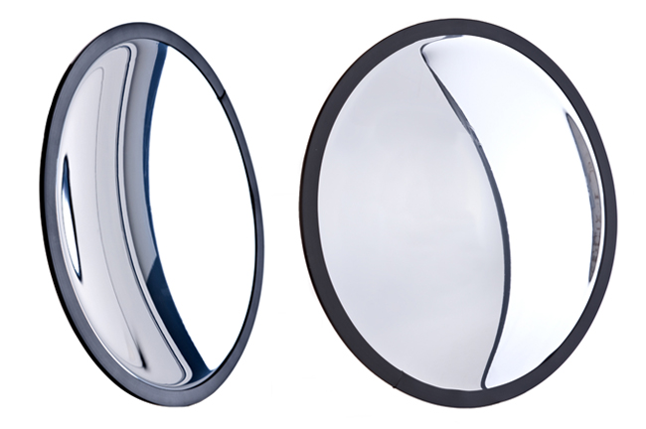
What happens when you have a smooth, shiny surface but it’s not flat?
What if it’s curved?
Do they make an image?
Or do they scatter light?
Curved Mirrors! Where have you seen them before?

Slide 8
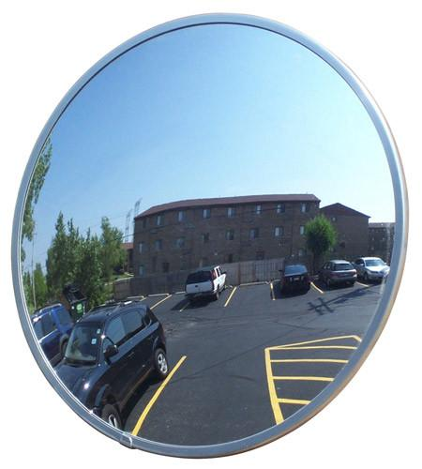
Convex Mirrors
A convex mirror produces a small image standing right side up.
It reflects back a larger area than a concave mirror does.
Convex mirrors are used for security purposes in stores.

Slide 9
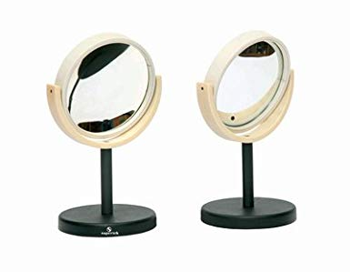
Concave Mirrors
A concave mirror can reflect in two different ways:
if the object is close, the mirror will make it appear larger and right side up.
if the object is farther away, the mirror will make it appear smaller and upside down.
Concave mirrors are used for shaving

Slide 10
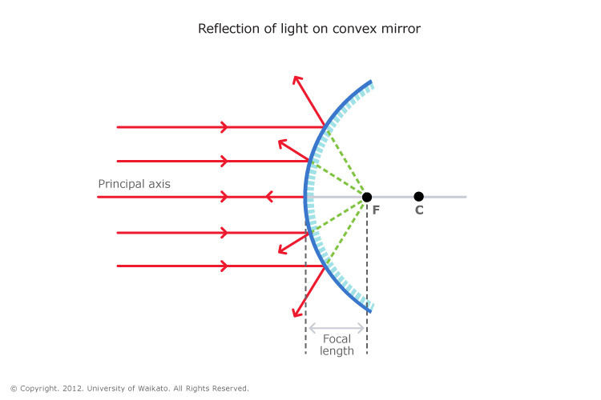
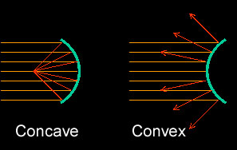
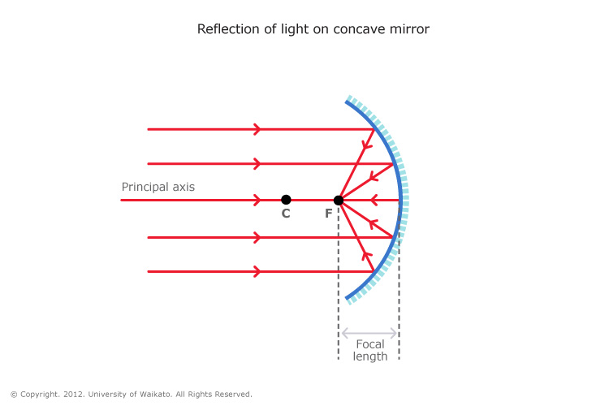
Using Curved Mirrors
Convex mirrors – always produce a smaller, up-right image.
Concave mirrors – produces a different image depending on where your object is placed.
1. If far away, it’s upside down and smaller.
2. If close, it’s up-right and bigger

Slide 11
https://www.youtube.com/watch?v=MlWhpr6-Rc8

Slide 12
Concave and Convex Mirrors
There are two kinds of spherical mirrors: concave and convex.
concave
convex
F

Slide 13
Spherical Mirrors
made from (polished) sections cut from a spherical surface
center of curvature C is center of original sphere
vertex V is center of mirror segment
Focus F, The point on the principal axis where paraxial (parallel to principal axis) light is reflected.
F
V
Principal Axis
C
principal axis (or optical axis) is line passing through C and V

Slide 14
Paraxial rays (parallel to the principal axis) get reflected through a common point the focal point or focus F.
C
F
V

Slide 15
Light coming from the object parallel to the axis will always reflect through F.
C
F
Concave Mirror

Slide 16
Light coming from the object and passing through C before it hits the mirror will always reflect back on itself.
C
F
Concave Mirror

Slide 17
Light coming from the object and passing through F before it hits the mirror will always reflect parallel to the axis.
C
F
Concave Mirror

Slide 18
Investigation
See what the two mirrors do
Do they create an image?
Where?
How?
What does the image look like?

