Slide 1
Review From Last Class

Slide 2
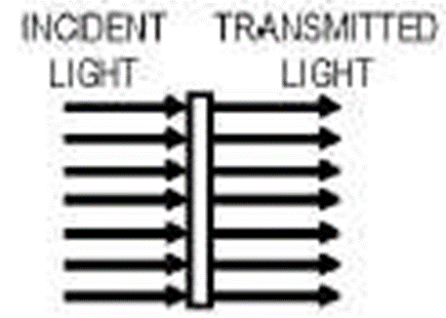
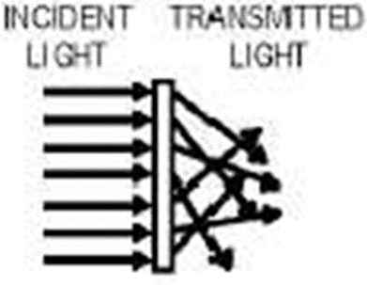
Transparent
Translucent
Opaque

Slide 3
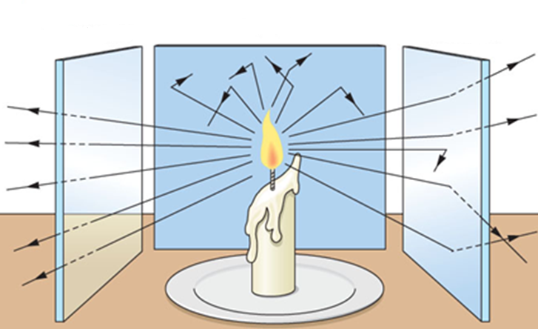

Slide 4
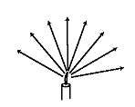
The Ray Model of Light
The ray model of light helps you to predict where shadows will form and how large they will be
Light travels in straight lines
Objects farther away from the light source cast a smaller shadow and objects closer to the light cast a larger shadow

Slide 5
Test it out- Shadows
In groups of 2 or 3 grab a flashlight a solid (opaque) object, and a ruler
Shine the flashlight on the wall and put the object between the beam of light and the wall approximately 10 cm from the flashlight and measure the diameter of the shadow it casts
Move the solid object approximately 20 cm from the flashlight and measure the diameter of the shadow casted now
Record your results on a sheet of looseleaf (one per group); draw a ray diagram that shows what is happening.

Slide 6
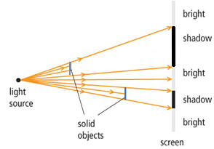
Ray Diagrams & Shadows

Slide 7
Shadows Lab Reflection Questions
Describe the relationship between the distance of the object between the flashlight and the screen and the size of the shadow cast.
Describe the relationship between the size of the object and the size of the shadow it casts.
Explain why a shadow was not formed in part 4. (paper perpendicular to flashlight and square)
Why did we need to turn the lights off to do this lab?

Slide 8
Lesson 4: Reflecting Light

Slide 9
LIGHT CAN BE REFLECTED
In order for something to act as a mirror and reflect an image, it has to be perfectly smooth

Slide 10
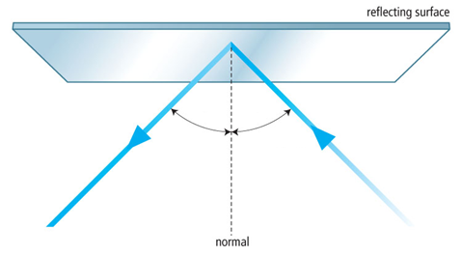
THE LAW OF REFLECTION
Light rays hit a mirror and bounce off (reflect off)
The incoming ray is called the incident ray
The outgoing ray is called the reflected ray

Slide 11
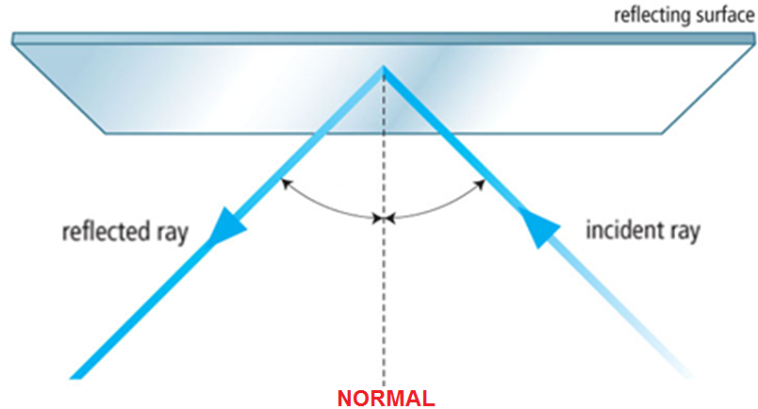
The incident ray and the reflected ray on either side of a line called the normal
The normal is an imaginary line that is perpendicular to the boundary

Slide 12
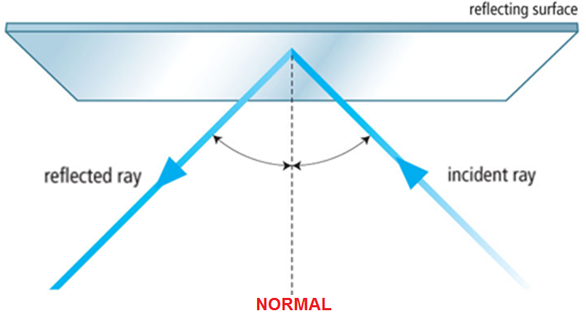
The angle made by the incident ray and the normal is called the angle of incidence (θ_{i})
The angle made by the reflected ray and the normal is called the angle of reflection (θ_{r})
(θ_{i}) is always equal to (θ_{r})
This is called the Law of Reflection

Slide 13
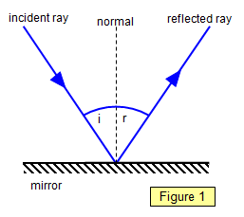
Reflection
When light strikes a reflective surface, it bounces off (reflects) the surface.
A light ray that strikes a surface is called an incident ray.
The light that is reflected from a surface is called a reflected ray.

Slide 14
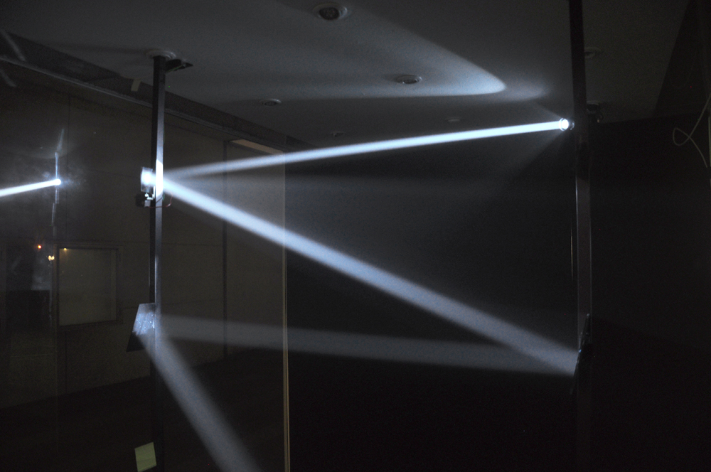
The line half way between the incident ray and the reflected ray is called the normal.
The angle between the incident ray and normal is called the angle of incidence (i).
The angle between the reflected ray and the normal is called the angle of reflection (r)

Slide 15
The point of incidence is the spot where the incident ray strikes the reflecting surface.

Slide 16
Reflection Worksheet
See worksheet
Reflection Lab
Reflection Target Activity

Slide 17
Refraction

Slide 18
LIGHT CAN BE REFRACTED
Light bends when it moves into different mediums
Light bends because the speed changes
The angle of refraction is the angle between the refracted ray of light and the normal

Slide 19
