Slide 1
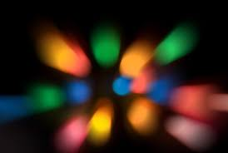
Optics
KWL

Slide 2
Review from last day
What is light?
Energy our eyes can see
What are the 2 sources of light?
Natural and artificial
What are objects called that give off their own light?
Luminous
What are all other objects called?
Nonluminous
How do we see the things around us that are not producing their own light?
Reflection
What can light be transformed into?
Electrical Energy, Thermal energy and Chemical Energy
What is intensity?
Light always travels in….

Slide 3
The Second Basic Principle of Light
Light travels in a straight line from its source
Light will continue to travel in a straight line until it hits something.
The light becomes less intense as it travels farther away, which can be seen in this picture.
(demo - smoke or chalk dust with laser pointer)

Slide 4
The only reason you can see the laser beam is because it is hitting the dust particles in the air – if there were no dust particles, you wouldn’t be able to see the light, except for where it hits the wall.

Slide 5
So light keeps on going….forever! Unless it hits something.
What happens when light hits something?
Besides reflecting and absorbing

Slide 6
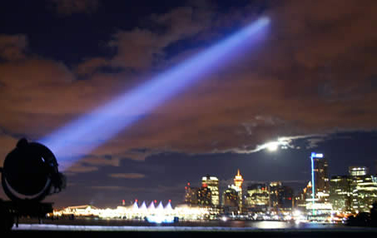
When light hits something, it can be reflected or absorbed…or it can pass through it, or be scattered, depending on what the object is like.

Slide 7
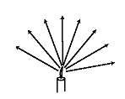
THE RAY MODEL OF LIGHT

Slide 8
LIGHT AND MATTER
The type of matter in an object determines the amount of light it reflects, absorbs, and transmits

Slide 9
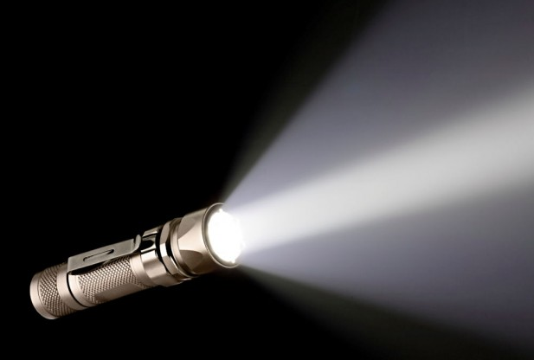
Activity
Explain what happens over here – describe what it looks like – try to explain why
Three objects – glass, wax paper and a piece of aluminum foil – how does light interact with them.
Your object
Glass, wax paper or aluminum foil
Think of other materials that would do the same thing

Slide 10
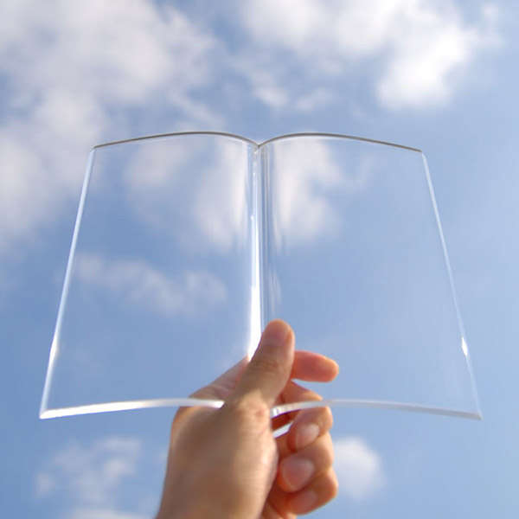
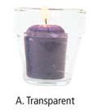
Transparent
If light passes through a substance or object , it is called transparent.
Objects can be clearly seen through the material
Examples:
Air
Water
Glass
Lenses in your eyes

Slide 11
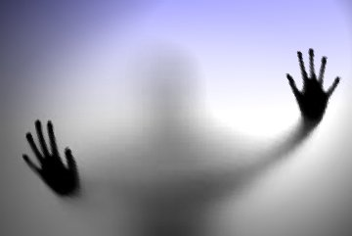
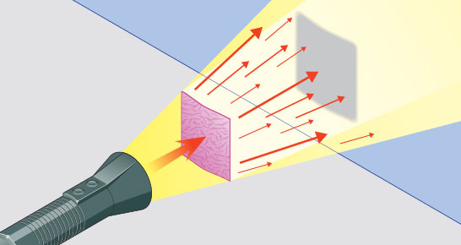
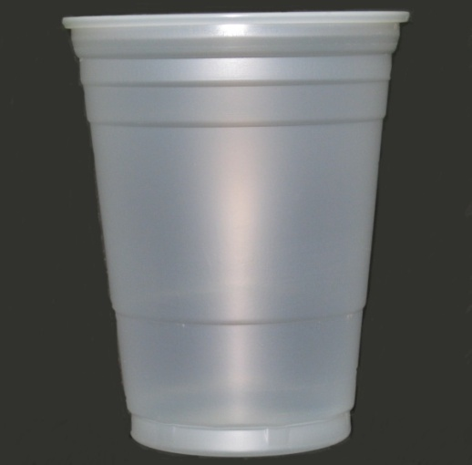
Translucent
If only some light passes through and the rest is scattered, it is called translucent. Objects cannot be clearly seen on the other side.
Produces faint shadows.
Examples:
Wax paper
Frosted glass
Plastic cup
Some minerals/gems
Leaves
Tissue paper

Slide 12
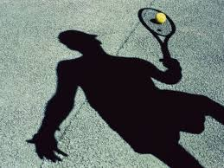
Opaque
If light is unable to pass through a substance or object it is called opaque.
Opaque materials block the passage of light and create shadows when light strikes them.

Slide 13
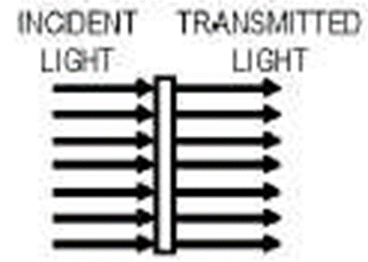
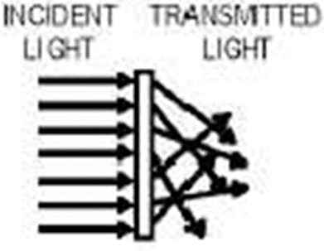
Transparent
Translucent
Opaque

Slide 14
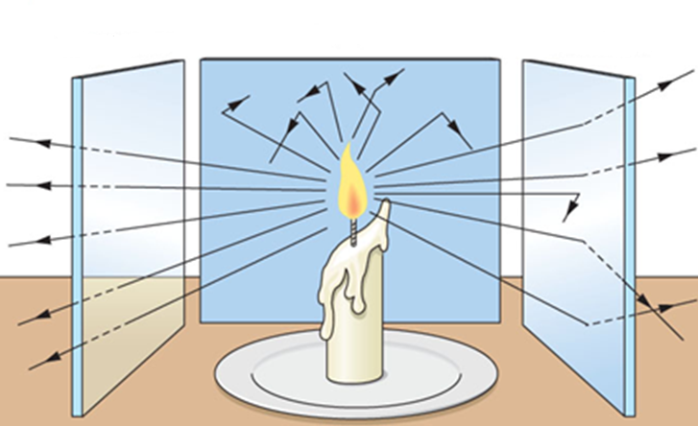

Slide 15
The Ray Model of Light
The ray model of light helps you to predict where shadows will form and how large they will be
Light travels in straight lines
Objects farther away from the light source cast a smaller shadow and objects closer to the light cast a larger shadow

Slide 16
Test it out- Shadows
In groups of 2 or 3 grab a flashlight a solid (opaque) object, and a ruler
Shine the flashlight on the wall and put the object between the beam of light and the wall approximately 10 cm from the flashlight and measure the diameter of the shadow it casts
Move the solid object approximately 20 cm from the flashlight and measure the diameter of the shadow casted now
Record your results on a sheet of looseleaf (one per group); draw a ray diagram that shows what is happening.

Slide 17
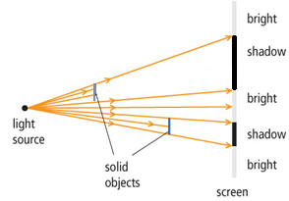
Ray Diagrams & Shadows

