Slide 1
Sources of Light

Slide 2
Review
What is light?
Energy our eyes can see
What are the 2 sources of light?
Natural and artificial
What are objects called that give off their own light?
Luminous
What are all other objects called?
Nonluminous
How do we see the things around us that are not producing their own light?
Reflection

Slide 3
First Basic Principle of Light
Light is a form of energy and when it reaches a surface it can be absorbed and transformed into other forms of energy
Solar cells change light into electricity
Trees change sunlight into chemical energy

Slide 4
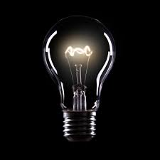
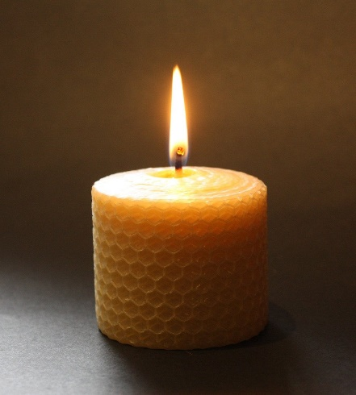
Sources of Light
1. Incandescent Sources
An object is heated to a very high temperature until it emits visible light.
Light bulbs and Candle flames
https://www.youtube.com/watch?v=YnMP1Uj2nz0

Slide 5
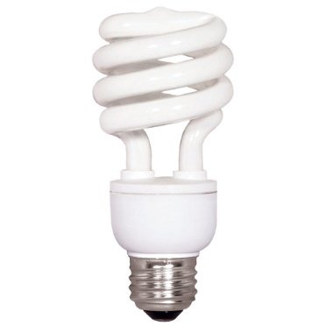
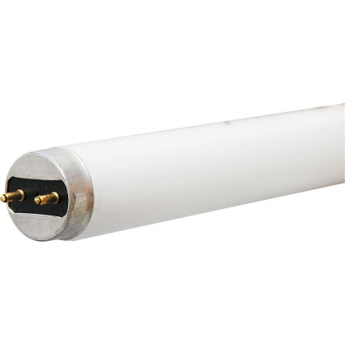
Sources of Light
2. Fluorescent Sources
A source that produces ultraviolet light by the ionization of mercury within a phosphor coated tube.
Fluorescent light bulbs
https://www.youtube.com/watch?v=YwsDvINxA84

Slide 6
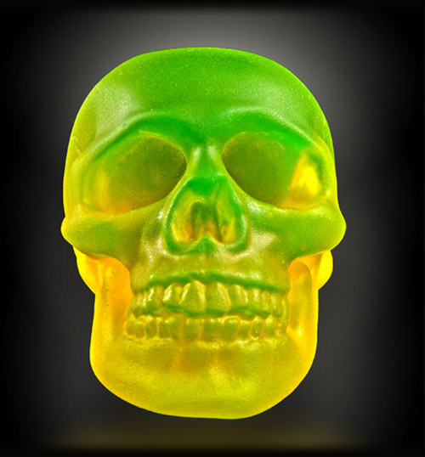
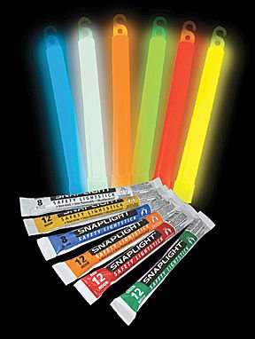
3. Phosphorescent Sources
The emission of light following exposure to and removal of a source of radiation.
Main difference between phosphorescent and fluorescent is – particles in a fluorescent source release their light immediately.
4. Chemiluminescent Sources
The chemical reaction that emits visible light and not involving heat
Glow sticks

Slide 7
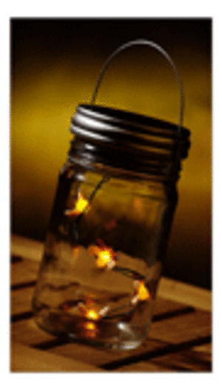
5. Bioluminescent Sources
An organism that relies on a chemical reaction within their body to produce light
Jelly fish and Squid
https://www.youtube.com/watch?v=UXl8F-eIoiM

Slide 8
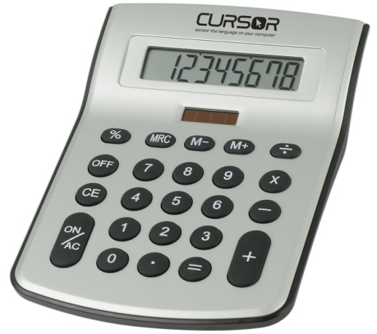
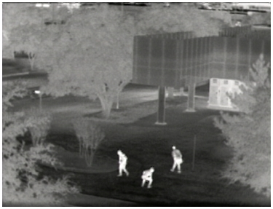
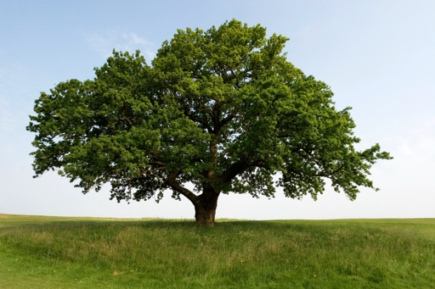
The First Basic Principle of Light
‘Light is a form of energy’ When light reaches a surface, it can be absorbed and transformed into other types of energy.
… into electrical energy … into thermal energy … into chemical energy
Solar cells change Cameras change light into Trees convert light energy into food
light into electricity thermal images (chemical energy)
The amount of energy a surface receives depends on the intensity of the light. The more intense the light, the more light can be absorbed.

Slide 9
Intensity Experiment
Why, if light travels in a straight line, does the page of the book appear brighter the closer it is to the flashlight?
Use a bright lamp!

Slide 10
Intensity Experiment
Why, if light travels in a straight line, does the page of the book appear brighter the closer it is to the flashlight?
The closer the book, the more light rays hit the book and the more intense the light appears (the brighter it is)

Slide 11
The Second Basic Principle of Light
Light travels in a straight line from its source
Light will continue to travel in a straight line until it hits something.
The light becomes less intense as it travels farther away, which can be seen in this picture.
(demo - smoke or chalk dust with laser pointer)

Slide 12
The only reason you can see the laser beam is because it is hitting the dust particles in the air – if there were no dust particles, you wouldn’t be able to see the light, except for where it hits the wall.

Slide 13
So light keeps on going….forever! Unless it hits something.
What happens when light hits something?
Besides reflecting and absorbing : )
We’ll find out tomorrow

