Slide 1
Unit 3: Light and Optics…

Slide 2
Learning Outcomes
I can describe five basic properties of light (straight line, light speed, reflection, refraction and dispersion, and what it can travel through) (308-8)
I can describe the laws of reflection of visible light (regular vs diffuse, < incidence = < reflection) (308-8)
I can explain definitions for angle of incidence and angle of reflection. (308-9)
I can estimate angles of incidence and reflection. (208-9, 209-6)
I can ask questions about reflection in a testable form. (308-10, 210-11)
I can predict the effect that see through objects of different thicknesses will have on the angle of refraction of light. (308-10, 210-11)
I can estimate angles of refraction. (308-10)

Slide 3
Learning Outcomes Continued
I can describe how visible light is refracted. (308-10)
I can find the focus point of a convex lens (focal length, focal point and convex). (109-5)
I can describe how lenses have developed over the years through trial and error. (109-5)
I can give examples of lenses in my everyday life and lenses that have helped science. (111-3)
I can describe different types of electromagnetic radiation. (308-11)
I can compare the properties of visible light to other forms of electromagnetic radiation. (308-11)
I can correctly use and define the terms frequency and wave length. (308-12)
I can describe some positive and negative effects of inventions associated with electromagnetic radiation. (112-8, 113-2)

Slide 4
Unit 3 Key Terms
Reflection
Reflected Ray
Angle of Reflection
Angle of Incidence
Incident Ray
Law of Reflection
Concave (lens)
Convex (lens)
Refraction
Microscope
Laser
Angle of Refraction
Retina
Iris
Pupil
Optic Nerve
Blind Spot
Focus
Near-sighted
Far-sighted
Telescope
Binoculars

Slide 5
Topic 1 Key Terms
Light
Natural light source
Artificial ( man made) light source
Incandescent
Fluorescent
Phosphorescent
Chemiluminescent
Bioluminescent
Ray Model
Ray Diagram
Translucent
Transparent
Opaque
Radiation
Electromagnetic spectrum
UV light
Infrared light
Visible Light
Microwaves
Radiowaves
X-Ray
Gamma rays
Frequency
Wavelength
Crests/Troughs

Slide 6
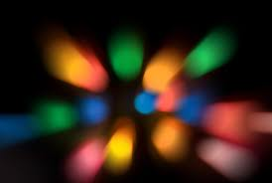
Optics
KWL

Slide 7
Know | Wonder | Learn

Slide 8
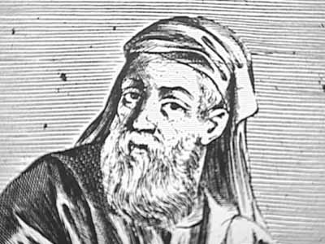
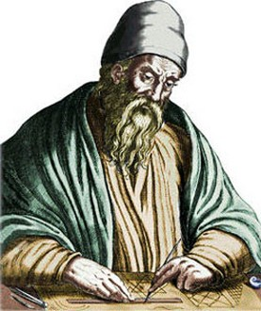
Experiment with the materials at your stations – any additional K or W’s?
What do you think? Experiments – tell me what you find out? Materials : flashlight – cup of water (clear cup), magnifying glass, mirrors, ruler, laser pointer, prism, different papers (opaque, transparent, translucent) - etc.
What the ancients thought
What they found out about reflection – measured angles – discovered refraction Measured angles
Source of light eyeball etc
Empedocles, Euclid

Slide 9
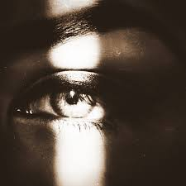
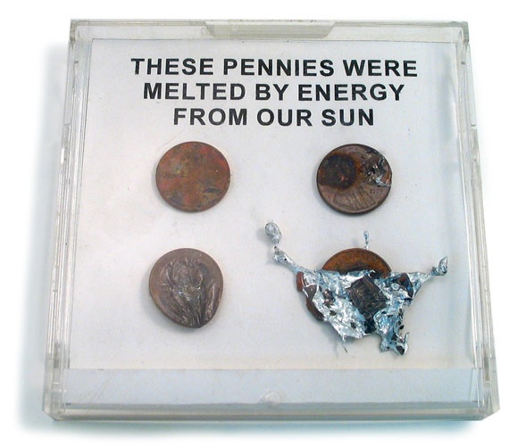
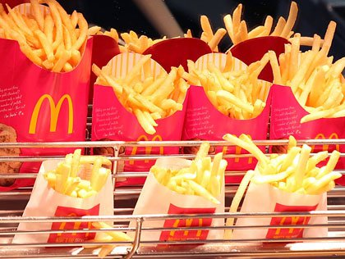
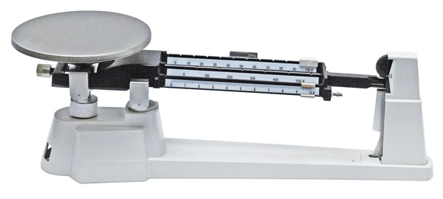
What is Light?
Light is not something you can taste or touch.
But you can see light and it can affect matter in different ways.
E.g. heat lamps keep fries warm at McDs
Does it have any mass?

Slide 10
So, light has no mass, so it can’t be matter…so what is it?
Energy!
Light is a form of energy that can be detected by the human eye.

Slide 11
Black out room
Find a room in the school with only one window.
Completely cover the window with a piece of plywood.
Cover the edges with aluminum foil.
Also cover the door window and door cracks with aluminum foil
Black out the room so that you can’t see your hand in front of your face – literally.

Slide 12
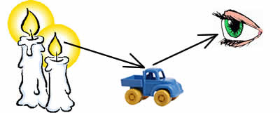
Black out room..completely!
We can see the flame because of the light that comes directly into our eye.
But how do we see other things in the room?
Reflection! Without light we were unable to see anything – but with one candle, light reflected off every object in the room and we could see everything!

Slide 13
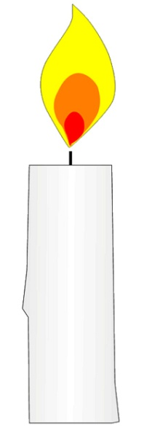
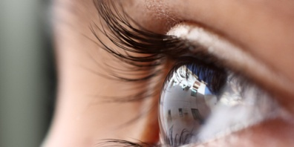
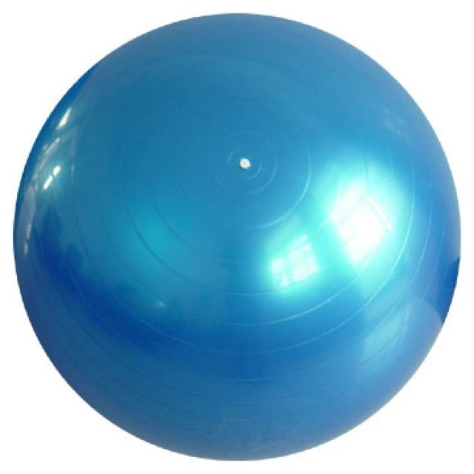
Diagram
Light travels directly from the source to your eye
Light reflects off objects and travels to
to your eye
Some of the light is absorbed and is transformed into thermal energy.

Slide 14
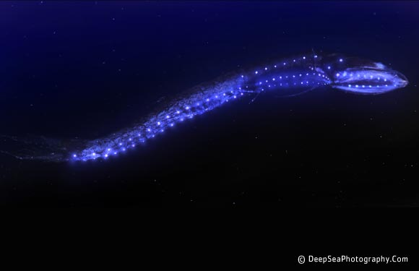
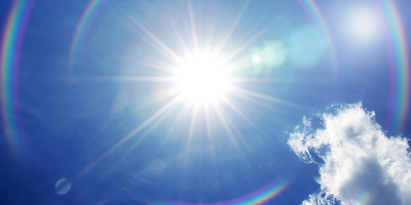
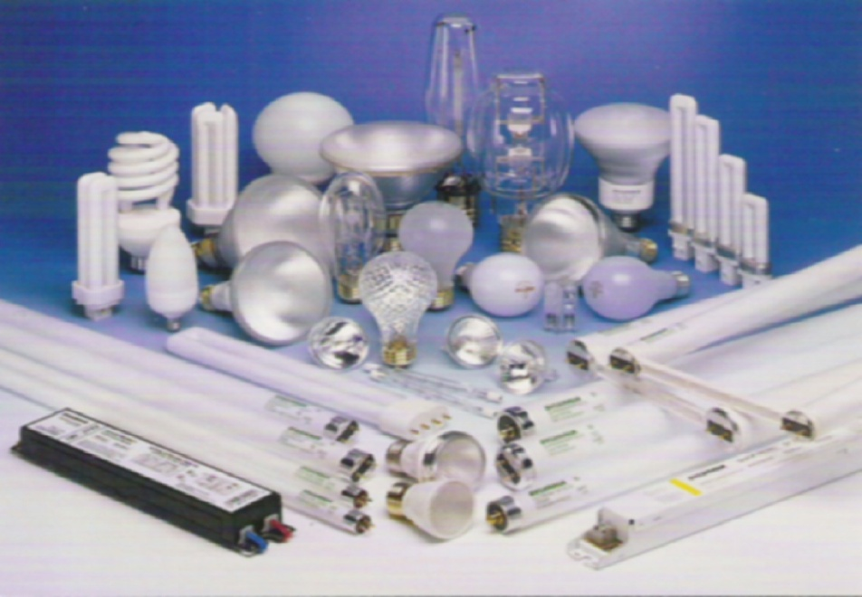
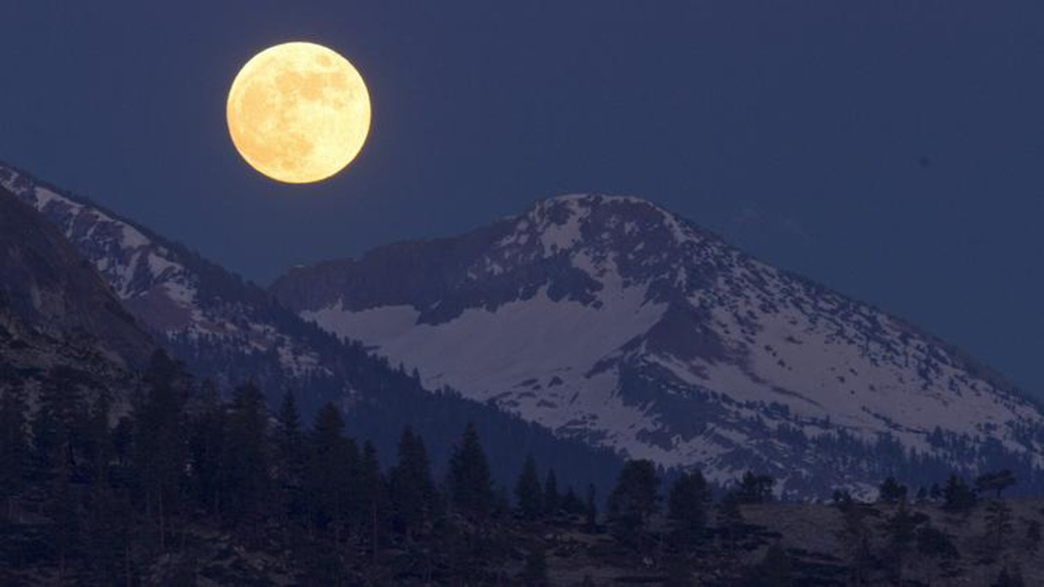
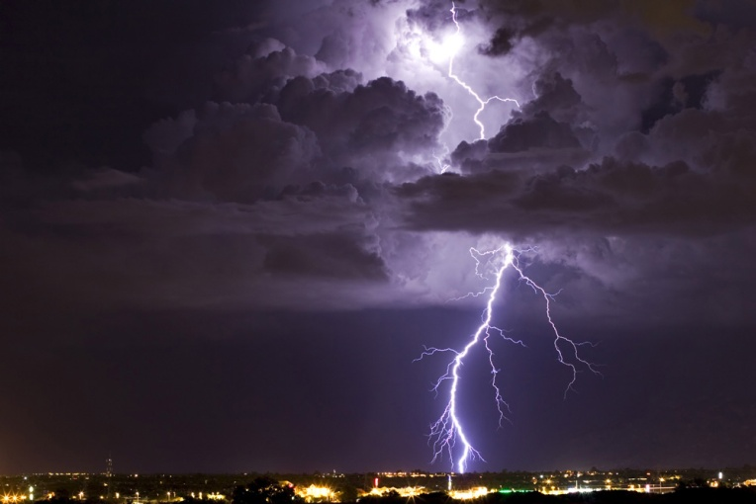
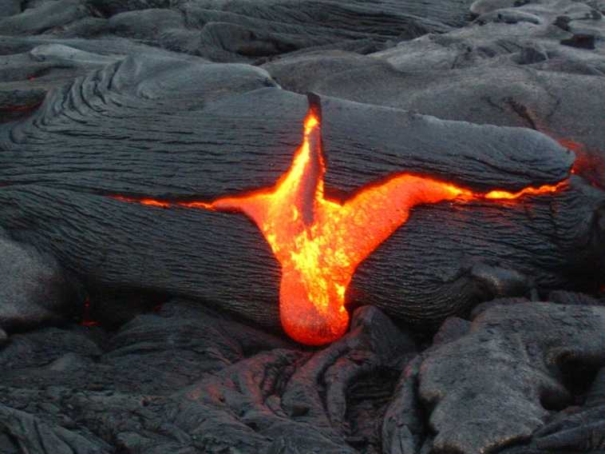
So where does light come from?
Natural light sources come from nature.
Artificial light sources are man-made light sources.
We see luminous objects because they give off their own light.
We see nonluminous objects because their surfaces reflect light. In total darkness we see nothing.

Slide 15
Assignment
Worksheet- Luminous Vs Non-Luminous
Luminous vs. Nonluminous

