Slide 1
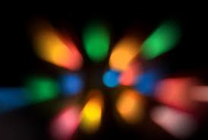
LIGHT
Dispersion and the Spectrum

Slide 2
Review 5 properties
And review dispersion – the visible spectrum from yesterday

Slide 3
What is light?
Light is a form of energy that is visible to the human eye.
Light is electromagnetic energy that is visible to the human eye.

Slide 4
There are many types of electromagnetic energy (light) but they all travel as waves at the speed of light.
All of the different types of light are arranged in the electromagnetic spectrum.

Slide 5
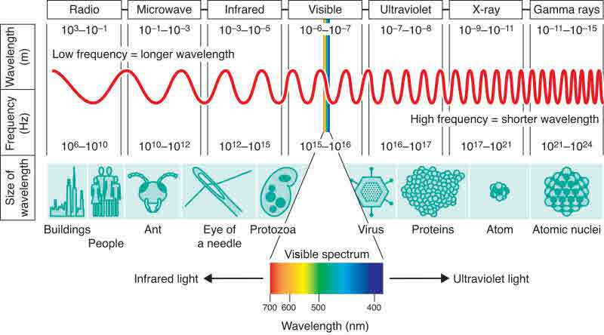
Electromagnetic Spectrum
These are the different kinds of radiation:

Slide 6
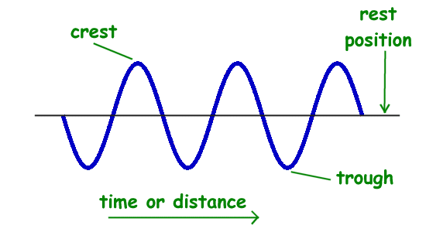
All electromagnetic energy travels in waves.
Demo – skipping rope

Slide 7
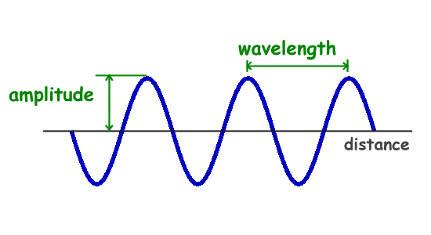
Wavelength – the distance from one crest to the next crest (or one trough to the next trough)

Slide 8
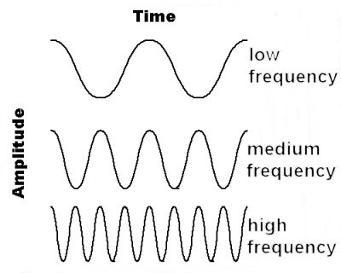
Frequency
The frequency is the number of waves that pass a point in one second (or a given unit of time)
in units called Hertz (Hz)

Slide 9
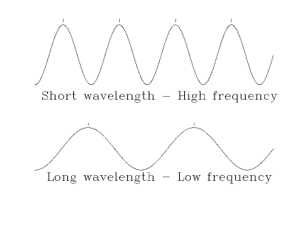
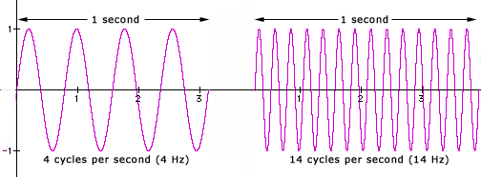

Slide 10
Which colour has:
1. The longest wavelength?
2. The highest frequency?
3. The shortest wavelength?
4. The lowest frequency?

Slide 11
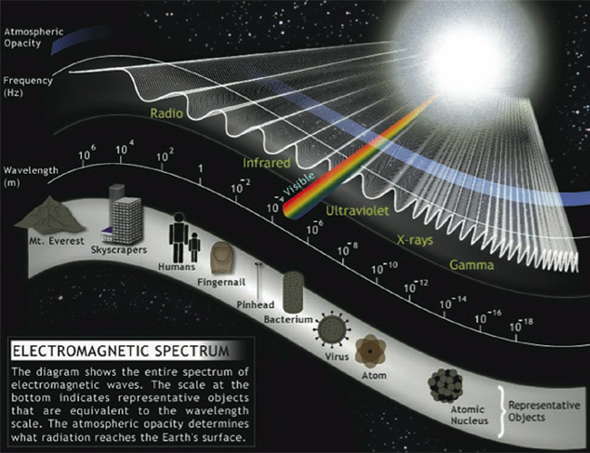

Slide 12
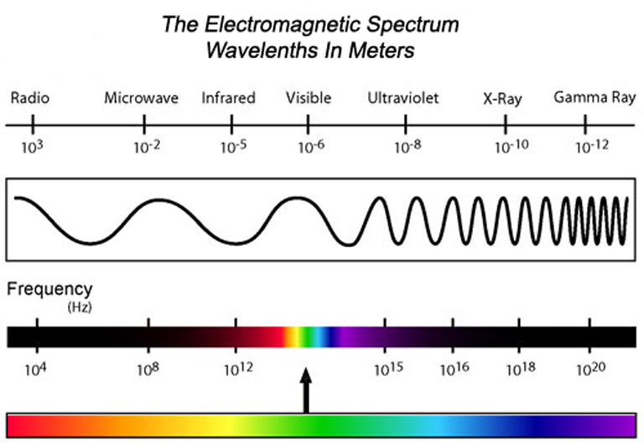

Slide 13
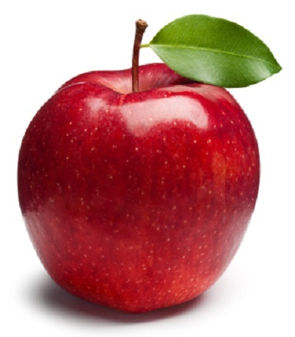
Why are objects the colours they are?
Why does an apple appear red?

Slide 14
Physics girl - color

Slide 15
Only R reflected
O-Y-G-B-I-V
absorbed
R-O-Y-G-B-I-V

Slide 16
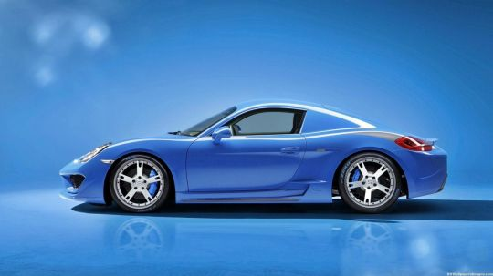
Post test
Why does this car look blue?

Slide 17
One last thing…
What is light?
Light are particles (photons) that behave as waves
Or….
light is a collection of one or more photons propagating through space as electromagnetic waves.

Slide 18
Wave simulator for later
Making waves – wave game
Light wave interference – slit

