Slide 1
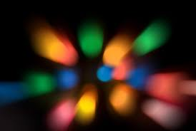
LIGHT
Intensity

Slide 2
Review
What is light?
Energy our eyes can see
What are the 2 sources of light?
Natural and artificial
What are objects called that give off their own light?
Luminous
What are all other objects called?
Nonluminous
How do we see the things around us that are not producing their own light?
Reflection

Slide 3
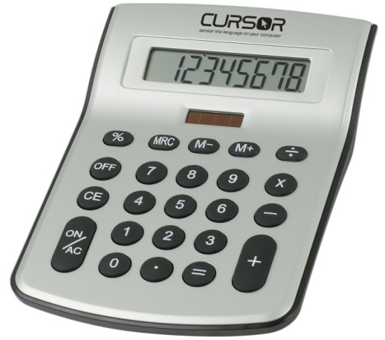
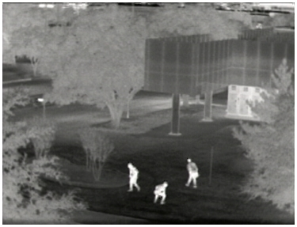
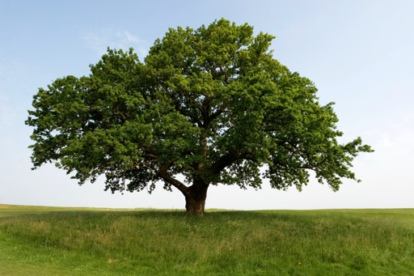
The First Basic Principle of Light
‘Light is a form of energy’ When light reaches a surface, it can be absorbed and transformed into other types of energy.
… into electrical energy … into thermal energy … into chemical energy
Solar cells change Cameras change light into Trees convert light energy into food
light into electricity thermal images (chemical energy)
The amount of energy a surface receives depends on the intensity of the light. The more intense the light, the more light can be absorbed.

Slide 4
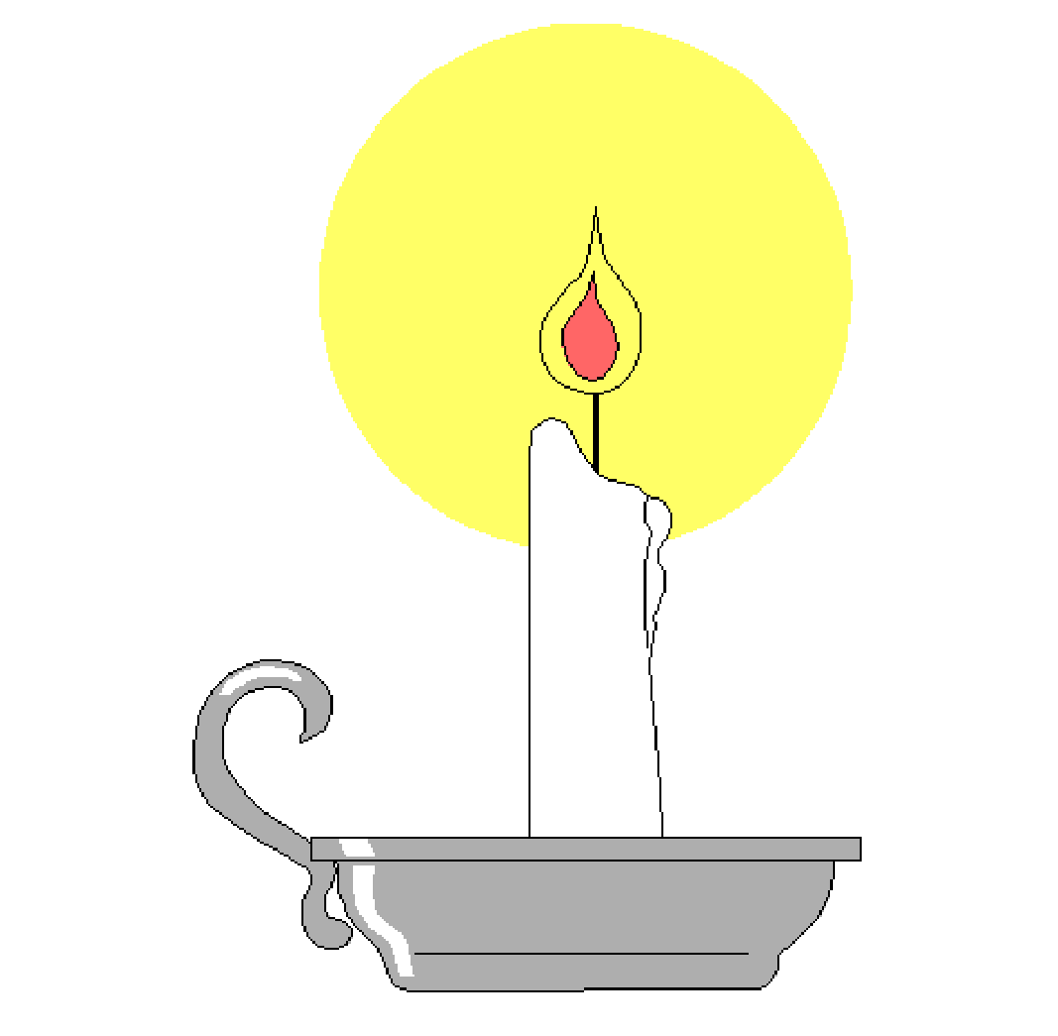
Intensity Experiment
Why, if light travels in a straight line, does the page of the book appear brighter the closer it is to the flame?
Use a bright lamp!

Slide 5
Intensity Experiment
Why, if light travels in a straight line, does the page of the book appear brighter the closer it is to the flame?
The closer the book, the more light rays hit the book and the more intense the light appears (the brighter it is)

Slide 6
The Second Basic Principle of Light
Light travels in a straight line from its source
Light will continue to travel in a straight line until it hits something.
The light becomes less intense as it travels farther away, which can be seen in this picture.
(demo - smoke or chalk dust with laser pointer)

Slide 7
The only reason you can see the laser beam is because it is hitting the chalk particles in the air – if there were no chalk particles, you wouldn’t be able to see the light, except for where it hits the wall.

Slide 8
So light keeps on going….forever! Unless it hits something.
What happens when light hits something?
Besides reflecting and absorbing : )
We’ll find out tomorrow

