Slide 1
Unit 2: Careers

Slide 2
Lifework Portfolio

Slide 3
LOGIN
SELECT→

Slide 4
Set up a Portfolio
Part A- Setting up your portfolio
Click on “Home”, “Portfolios” and “+ Add Portfolio”
Type your first and last name for the Portfolio title
Click on “+ update banner image”. Add a photo that represents who you are or an interest of yours.
Change the avatar as well (you can put a picture of you or something else that interests you)

Slide 5
Who Am I Surveys
Part B- Who am I Surveys
Complete the surveys in the “Who am I” tab. At the end of each survey read your results.
Learning Styles
Personality
Interests
Knowledge
Motivations
*Add each completed survey to your portfolio!!!!
*RECORD YOUR RESULTS ON YOUR myblueprint worklife portfolio template & rubric

Slide 6
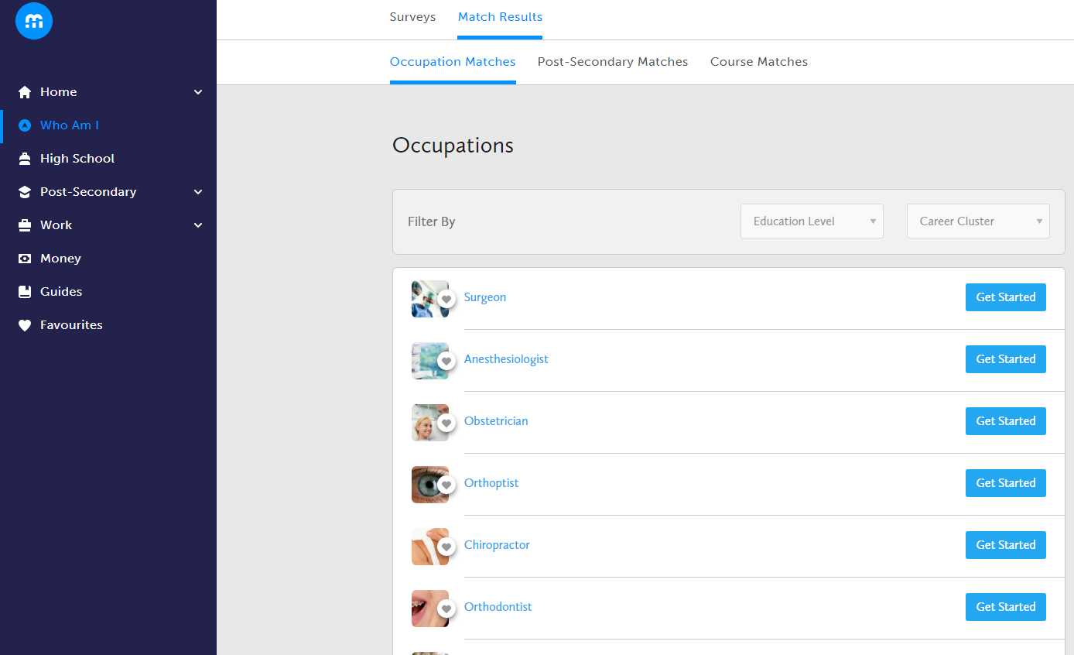
Career Matching
*BEFORE YOU COMPLETE THIS PART YOU MUST HAVE YOUR 5 SURVEYS COMPLETED FROM LAST CLASS
Part C:Occupation Match
Click on “Home”, “Dashboard”, “Suggested Occupations”
OR
Click on “Who am I” and “Match Results”
Search for one career you are interested in and click on the name of the career (shows up blue)

Slide 7
If you are still interested in the career click on “Get started” to take the survey to see if you are compatible
If you are a good match or you're or not a good match but still very interested in that career click on the “heart” to add to your “Favourites”
Also add this career to your portfolio if interested in it
FILL IN ALL 3 CAREER CHOICES IN YOUR FOLDER!****

