Slide 1
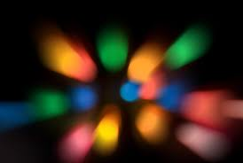
LIGHT
Lenses

Slide 2
Once we understood how refraction occurred, lenses were created to refract light in specific ways.
Here are a few of the different types of lenses that exist:

Slide 3
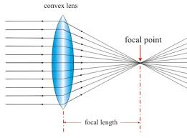
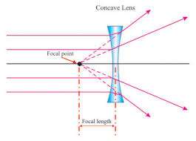
Each of the different kinds of lenses refract (bend) light in a unique way.
E.g. A convex lens
A concave lens
Activity – looking at lenses

Slide 4
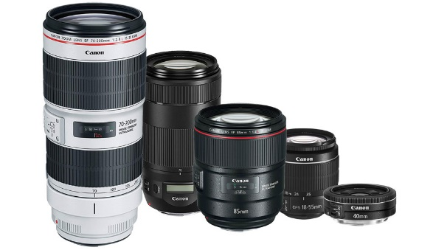
Lenses
A curved piece of transparent material that refracts light in a predictable way.
Usually made from glass or plastic.

Slide 5
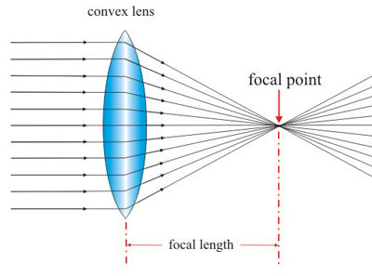
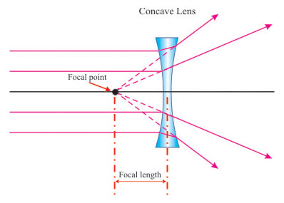
Types Lenses
Convex Lenses
Concave Lenses
Centre of the lens bulges out
Causes light rays to bend toward each other (converge)
Can act as a magnifying glass
Each lens has its own focal length (the distance from the centre of the lens to the focal point)
Centre of the lens is curved in
Causes light rays to bend away from each other (diverge)

Slide 6
Convex Lenses
The greater the curvature of the lens, the shorter the focal length.
Lenses have focal points on either side because light shines through either side.
The line through the centre of the lens is called the principle axis.

Slide 7
Concave Lenses
To find the focal point, you must extend the refracted rays back.
Lenses with the greater curvature have the shortest focal length.

Slide 8
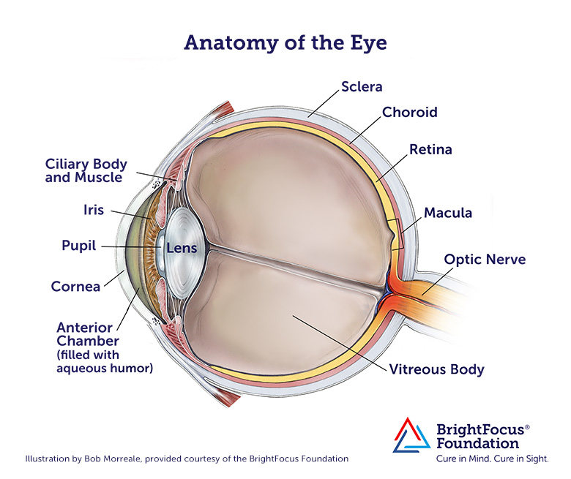
Corrective Lenses

Slide 9
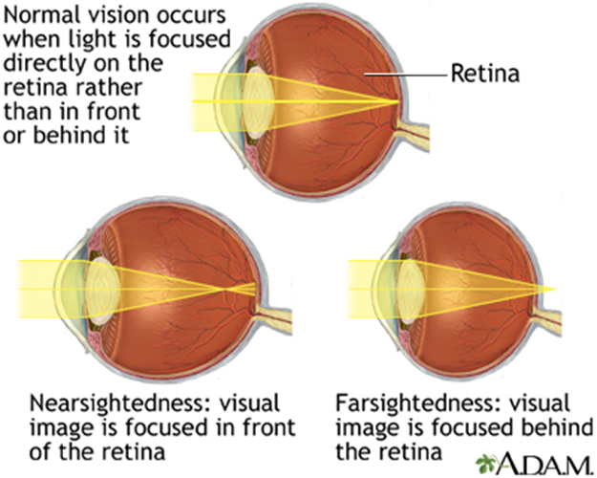
Your eyes have lenses. They refract the light so it focuses the light on the back of your eye.

Slide 11
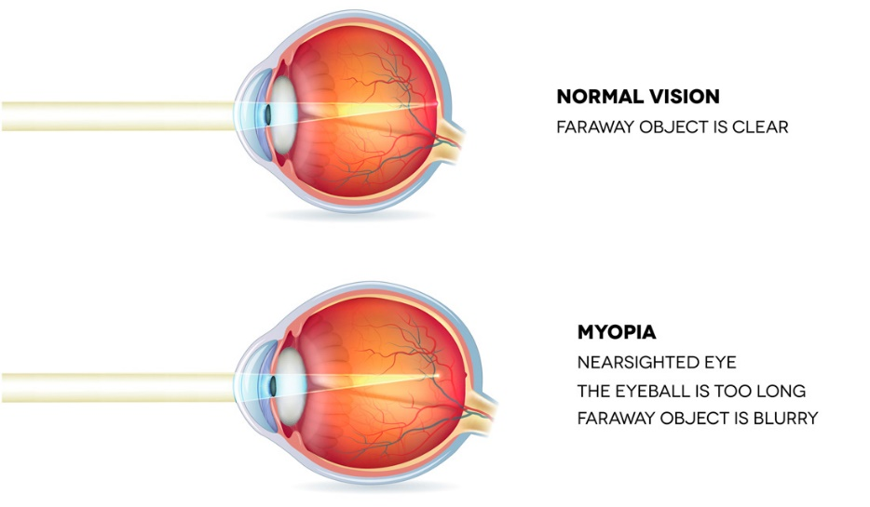
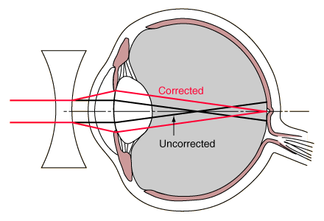
Nearsightedness (Myopia)
See objects up close but not at a distance.
Concave lenses are used to correct this vision.
Eyeball is too long, and light is focused before it hits retina

Slide 12
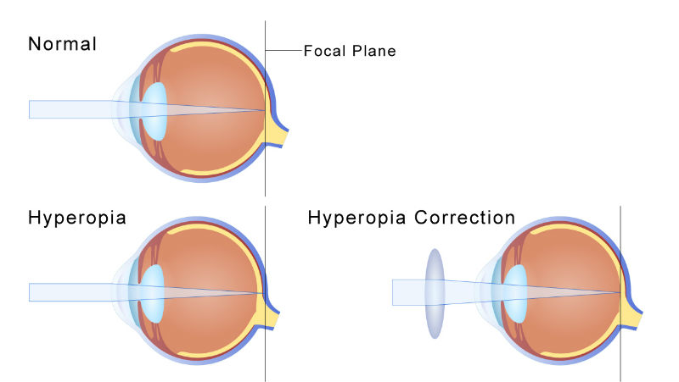
Far Sightedness (Hyperopia)
See objects at a distance but not up close.
Convex lenses are used to correct this vision.
Eyeball is short and doesn’t bend light enough so focus is behind retina

Slide 13
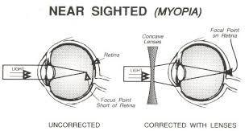
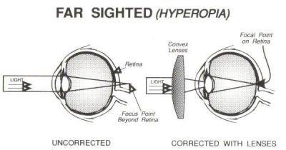
We use glasses to refract the light and make it focus where it’s supposed to be

Slide 14
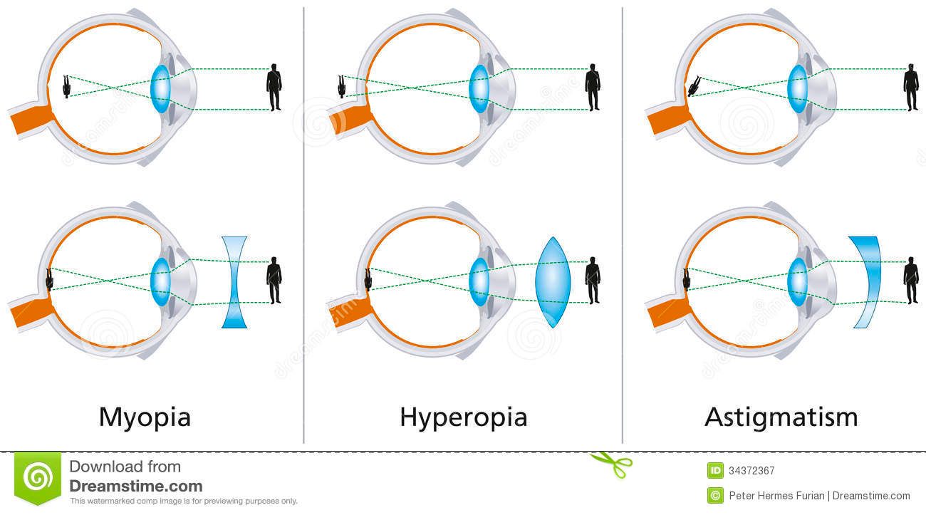

Slide 15
Lenses animation

