Slide 1
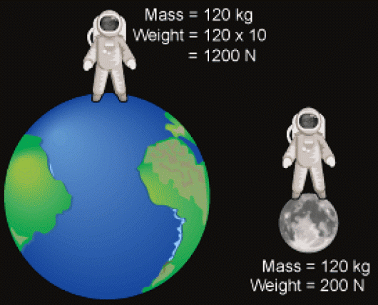
Mass vs Weight
https://www.youtube.com/watch?v=rFdbY_V7vIo

Slide 2
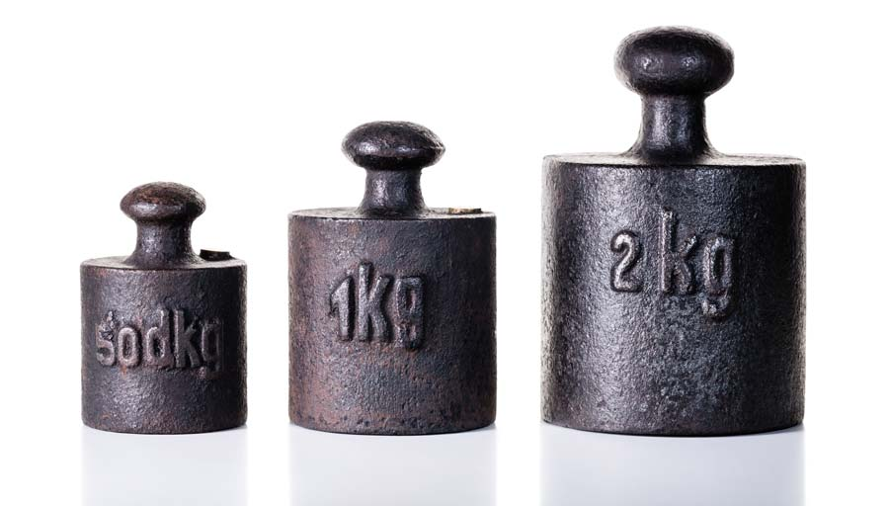
Mass
The amount of stuff in an object
Doesn’t change based on where you are in the solar system or universe
Given in grams, kilograms, pounds, ounces etc

Slide 3
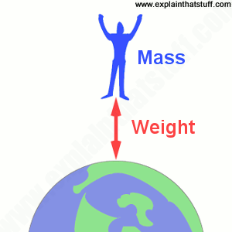
Weight
the force on an object due to gravity
Depends/changes based on what the gravitational force is
Given in units called Newtons (N)

Slide 4
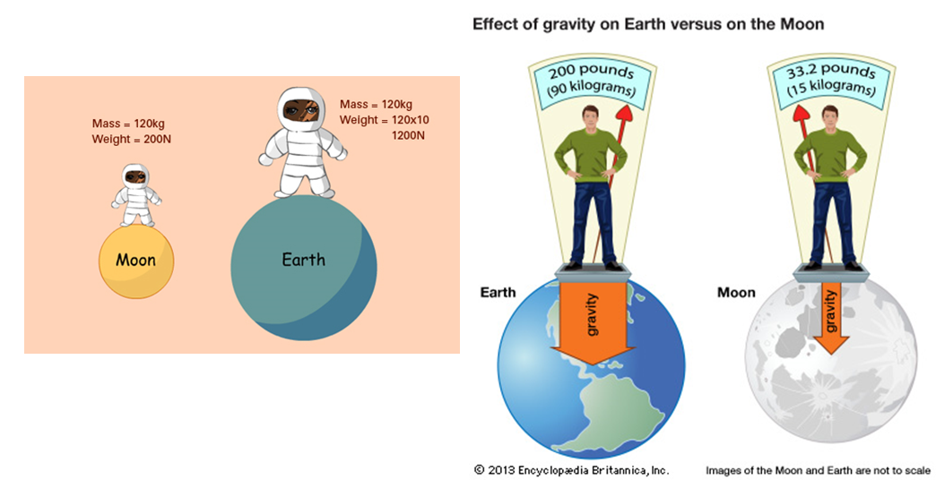
Similarities and Differences

Slide 5
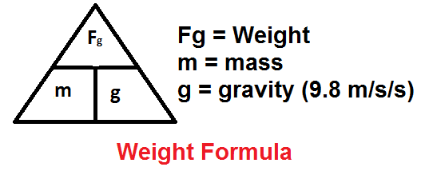
Mass and Weight Relationship
Mass and Weight are proportional on Earth
For every 1kg of mass, there is 9.8N of gravitational force (ON EARTH) pulling down on the object
The equation for calculating the weight of an object on Earth is: Weight in Newtons=(mass in kg)x(9.8)
So, a 100kg human would have a weight of _________________
W=100kg*9.8N/kg

Slide 6
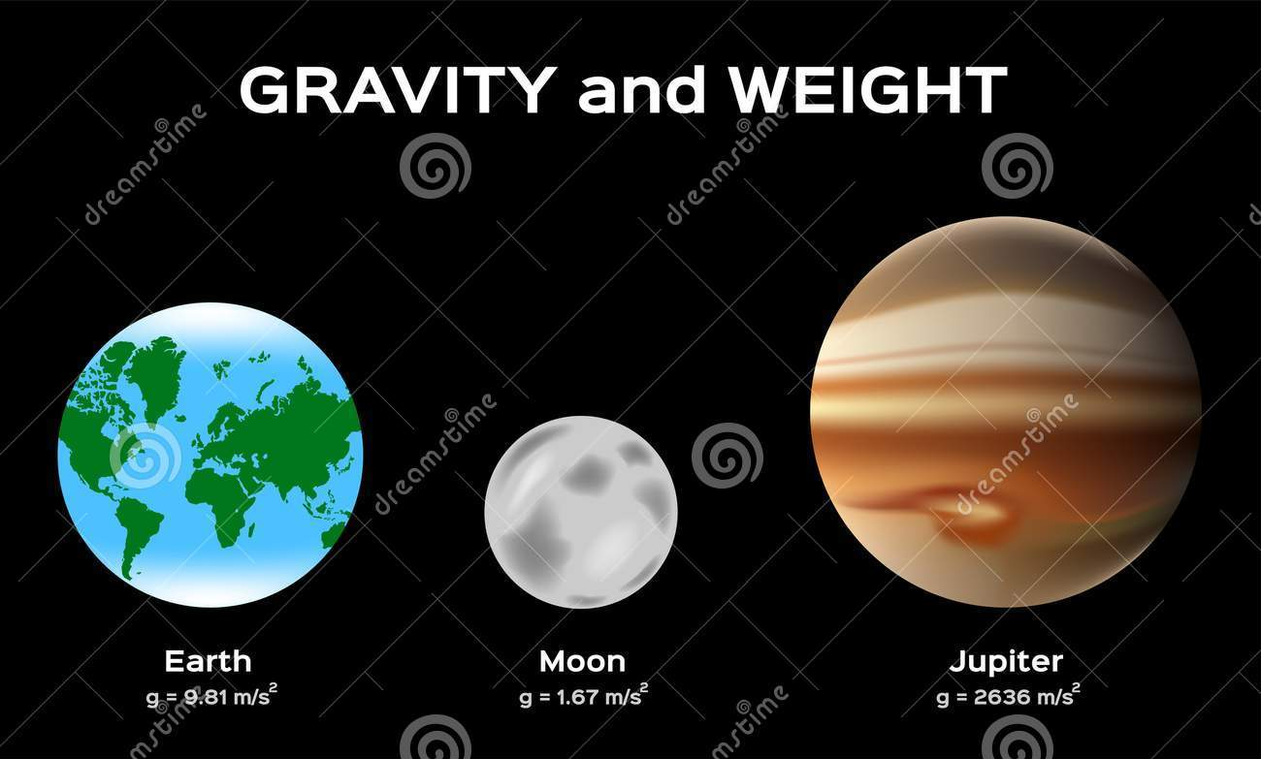
Mass and Weight Relationship
 | Earth | Moon | Jupiter
Mass | 100kg | 100kg | 100kg
Gravitational force | 9.8N/kg | 1.6N/kg | 23.2N/kg
Weight
980N
160N
2320N

Slide 7
Gravity and Weight
Sleeping on ISS https://www.youtube.com/watch?v=UyFYgeE32f0
Zero G Flight: https://www.youtube.com/watch?v=FO_Ox_dH0M8

Slide 8
Worksheet
Calculate your Weight on the different planets! Use the scale to find out how much you weigh
Need a calculator
convert lbs to kgs (your weight in lbs ÷ 2.2= ______kg)
Hand in when finished
Grab a chromebook and explore the following websites:
https://www.exploratorium.edu/ronh/weight/
http://www.sciencekids.co.nz/gamesactivities/detectivescience/gravity.html
https://www.explorelearning.com/index.cfm?method=cResource.dspDetail&ResourceID=653 (5 minute trial)
https://www.nasa.gov/audience/foreducators/topnav/materials/listbytype/Mass_vs_Weight.html

