Slide 1
_________________
Le dictionnaire est ton ami!
L/O: To learn how to use the bilingual dictionary effectively
“Oui! Je suis ton ami!”

Slide 2
Nouns
You will always need to know whether a noun (ie. a thing… like table/ door/ chocolate) is masculine or feminine. In the Collins dictionary we use in class, masculine nouns always have nm (noun, masculine) after them and feminine nouns always have nf (noun feminine) after them.

Slide 3
1) finger
2) peach
3) stress
4) test
5) direction
6) coffee
7) apple
8) food
9) picnic
10) fly
11) clock
12) mouse
(le) doigt- masc
(la) pomme - fem
(la) pêche - fem
(la) nourriture - fem
(le) stress - masc
(le) pique-nique - masc
(l’) interrogation - fem
(la) mouche - fem
(la) direction - fem
(l’) horloge - fem
(le) café - masc
(la) souris – fem

Slide 4
Irregular plural nouns
Sometimes you will need to know the plural form of a noun, for example if you want to talk about pencils (instead of just one pencil).
Most plural nouns follow a set pattern (add s/) but some are irregular. If a plural noun is irregular, the dictionary will tell you what the plural form is.
You will need start by looking for the singular version of the noun, eg. pencil NOT the plural version. Next to the singular option, will be the plural option (pl) in brackets.

Slide 5
Find the plural for:
13) eye
14) work
15) knee
16) cabbage
17) newspaper
yeux
travaux
genoux
choux
journaux

Slide 6
Adjectives – how to make sure they agree
Adjectives always need to agree with the nouns they are describing, and so are often given in the masculine and feminine forms in the dictionary. The masculine form will be the first option given, and the feminine will be given afterwards (or in brackets)
heureux/ heureuse
18) happy
19) noisy
20) useless
21) neat
22) new
23) little
bruyant / bruayante
nul/ nulle
soigné/ soignée
nouveau/ nouvelle
petit/ petite

Slide 7
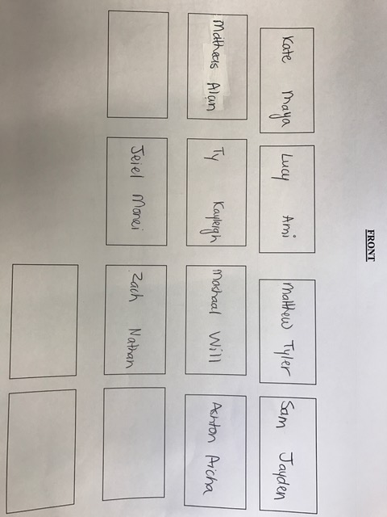
Seating Plan 701

Slide 8
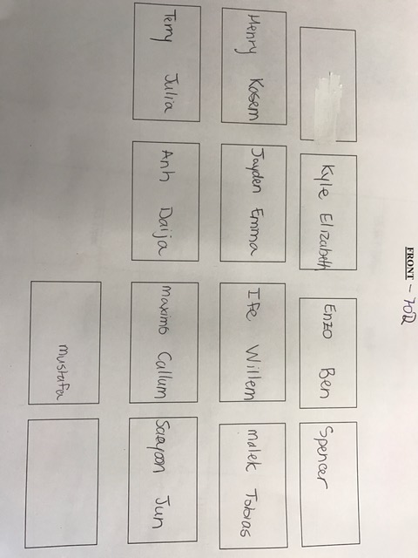
Seating Plan 702

Slide 9
Understanding how to choose the correct option when lots of options are given for a word
Sometimes your dictionary gives you several meanings for one word. Make sure you read through all the entries and choose the right option.
eg. if you look up ‘bat’ you will find :
la batte (for baseball, cricket)
la raquette (for table tennis)
la chauve-souris (animal)
Not choosing the correct option can lead to sentences that don’t mean what you want them to mean... eg. Je joue au cricket avec une chauve-souris

Slide 10
24) The cave was dark and a bat flew out.
25) We arrived at the station late and missed our connection.
26) The elephant had a very small trunk.
27) I normally apply only two coats of paint.
28) I went to the shop for a hammer and a nail.
chauve-souris (f)
correspondance (f)
trompe (f)
couches de peinture (f)
clou (m)

Slide 11
Sometimes there are several options for verbs too. Once again, you must read the options available, and choose the one that is correct.
eg. if you look up ‘to put on’ you will find:
mettre (clothes, lipstick)
allumer (light, TV)
monter (play, show)
mettre à cuire (eg. I’ll put the potatos on)
grossir (weight)
Find the correct French verb for each option below:
29) To bother → a) (worry) b) (disturb)
30) To rest → a) (relax) b) (lean something)
tracasser
déranger
se reposer
appuyer

Slide 12
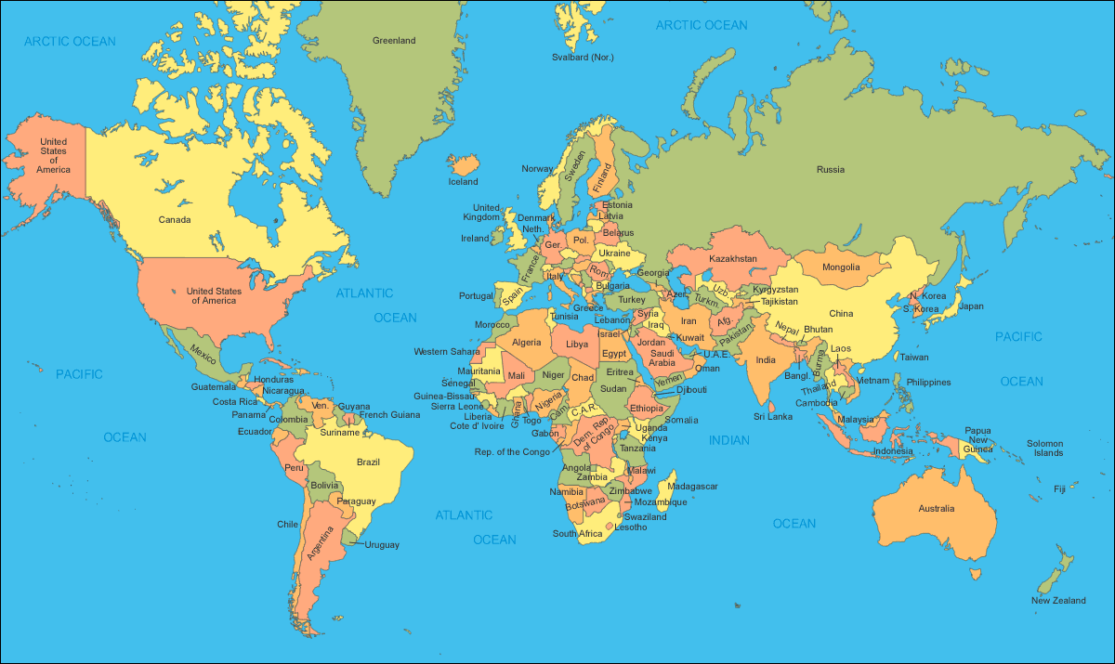
DICTIONARY CHALLENGE
Extn: Can you think of another French speaking country and make up your own puzzle?
1. 2. 3. 4.
Haiti
Canada
Belgium
Senegal
Notes:
See Word document for challenge boxes on.

Slide 13
At the end of the dictionary, there are lots of verb tables to help you form verbs correctly in different tenses. In order to use these correctly, you must first understand when each tense needs to be used:
The present – (I) play
The passe compose – (I) played
The imperfect – (I) was playing
The future – (I) will play
When you find the verb you need to use in the french pages of the dictionary, it will be in the infinitive; this means that it will mean to do something (eg parler = to talk/ écouter = to listen), and so you will probably need to form it into one of the tenses above.

Slide 14
Firstly, you need to find the infinitive of the verb you want to conjugate (form) in the FRENCH-ENGLISH side of the dictionary (this means you might need to look up the verb in the English-Spanish side, and then again in the Spanish-English side!). Next to the verb there will be a number. This number refers to the verbs in the tables
Eg. Envoyer VERB [34]

Slide 15
Subject pronouns
je I
Tu you
Il/elle he/she
Nous we
Vous you all/you polite
Ils/elles they
Now find the French for the following: (REMEMBER to make sure that you choose the correct ‘person’
31) I go out = je sors
31) he says _____________
32) you want _________________
33) He takes_________________
34) We give _________________
35) We do _________________
36) They finish _________________
37) You throw _________________
38) They see _________________
il dit
Tu veux
Il prend
Nous donnons
Nous faisons
Ils terminent
Tu jettes
Ils voient

Slide 16
