Slide 1
Dans ma Salle de classe
https://www.youtube.com/watch?v=098Xf9d-Ntw

Slide 2
DUE: Le Materiel Scolaire!
Mettez dans la BOITE 801!

Slide 3
OUTCOME: TO SAY WHAT I HAVE IN MY SCHOOL BAG/BINDER IN FRENCH
How to demonstrate: TO BE ABLE TO RECOGNISE 10 WORDS FOR SCHOOL SUPPLIES. TO BE ABLE TO WRITE A SHORT PARAGRAPH DESCRIBING WHAT I HAVE IN MY SCHOOL BAG or BINDER
WRITE THE DATE IN FRENCH AND THIS TITLE…
DANS MON SAC/CARTABLE

Slide 4
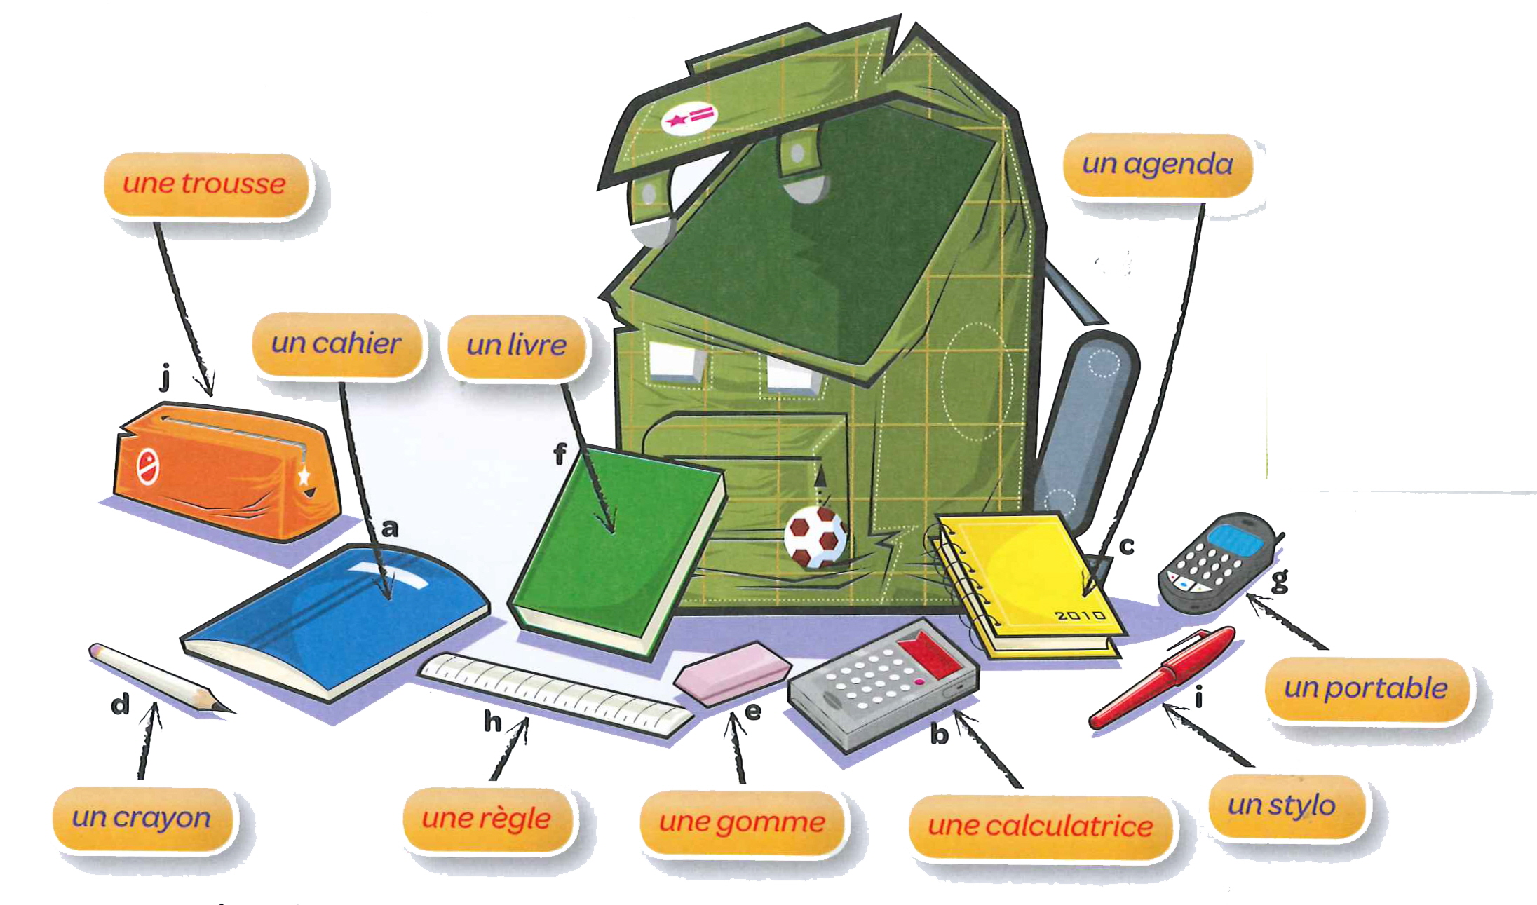

Slide 5
REMEMBER THIS FROM PREVIOUS LESSONS?

Slide 6
DON’T FORGET TO ADD “UN” OR “UNE”

Slide 7
COPY THIS INFORMATION AND EXAMPLE INTO YOUR BOOK. IT WILL HELP YOU WITH THE NEXT EXERCISES.
KEY PHRASE – “IL Y A” = “THERE IS” OR “THERE ARE”
REMEMBER, TO MAKE SOMETHING PLURAL IN FRENCH, MOST OF THE TIME YOU ADD AN “S”, LIKE IN ENGLISH. (CHECK BACK TO THE LESSON ABOUT “PETS” FOR A REMINDER)

Slide 8
COPY AND COMPLETE THE PARAGRAPH BELOW, REPLACING THE PICTURES WITH SUITABLE WORDS. THEN TRANSLATE IT INTO ENGLISH.

Slide 9
COPY AND TRANSLATE THE PARAGRAPH BELOW INTO ENGLISH.

Slide 10
WRITE A DESCRIPTION IN FRENCH OF THE FOLLOWING PENCIL CASES. USE THE PARAGRAPHS FROM THE PREVIOUS EXERCISES AS TEMPLATES TO HELP YOU.

Slide 11
Qu’est-ce que il y a dans ton sac a dos?
Écrivez un phrase complète qui décrit les objets dans ton sac a dos (ou cartable, ou trousse). Mettez au moins 4 objets.
Souvenez-vous l’exemple:
EXTENSION TASK: WRITE A DESCRIPTION IN FRENCH OF YOUR OWN SCHOOL BAG. USE WWW.WORDREFERENCE.COM TO FIND OUT ANY NEW WORDS TO INCLUDE.

