Slide 1
Drug and Alcohol Use

Slide 2
Factors Surrounding Drugs
There are three main factors to keep in mind when considering using drugs:
  The Drug
  The User
  The Context

Slide 3
What are drugs?
What is the definition of a drug?
Are all drugs bad?
Can “good drugs” be dangerous?

Slide 4
What Are Drugs?
Substances, other than food, that affect a person’s mental, emotional, or physical state
Often used to describe illicit street drugs
There are many types that are legal and used regularly (ex: alcohol, caffeine, nicotine) aka: “invisible drugs”
Prescription medications and Over the Counters also classified as “drugs”

Slide 5
Types of Drugs
Drugs are classified by effect on the body:
Uppers: stimulants
Downers: depressants
All arounders: various effects (Ex: hallucinogens, can act like both uppers and downers)

Slide 6
Research
In pairs, get a chromebook and go to the following website https://teens.drugabuse.gov/teens/drug-facts
Read through the various articles and classify each of the drugs under the one of the 3 types of drugs (Uppers, Downers, All Arounders)

Slide 7
Uppers (Stimulants)

Slide 8
Downers

Slide 9
Tranquilizers

Slide 10
Alcohol

Slide 11
Inhalants

Slide 12
Exit Slip
What are drugs used for?
Do drugs affect everyone in the same way? Why or Why not?
Can drugs that are used medically be harmful?
How do the different classes of drugs affect the body?

Slide 13
Drugs and the Brain
The largest part of your brain is the cerebral cortex. When it’s functioning normally, this section takes care of thinking, seeing, hearing, and the sense of touch. Next is the cerebellum. The cerebellum coordinates movements you do everyday, such as brushing teeth and riding a bike. Just above the spinal cord, a small section of your brain called the brain stem controls basic functions, such as breathing, digesting food, and maintaining your heartbeat. Then, there’s the limbic system, also known as the emotional brain. This is where feelings like fear and passion are born. Scientists have identified a “reward pathway” in the brain that includes the nucleus accumbens. When we do something that is key to survival, such as eating when we are hungry, the reward pathway is stimulated. Most addictive drugs also stimulate this reward pathway, often more than natural rewards, such as food. How do drugs affect your brain? Once in the brain, drugs of abuse are similar in size and shape to brain chemicals called neurotransmitters. Brain cells release and absorb these natural chemicals in order to send and receive messages to and from each other. Drugs disrupt this delicate communication system, and can hurt your brain.

Slide 14
Depressants
Depressants impact the body’s CNS (central nervous system). They slow the user down and are often called “downers.”
Sometimes prescribed for anxiety, insomnia, OCD, and other medical issues that prevent the person from fully relaxing.
These drugs offer a sedative experience, making them a tempting choice for people who wish to escape everyday stress.

Slide 15
Depressants - Effects
Higher risk of high blood sugar, diabetes and weight gain
Increased body temperature
Delirium
Sluggish thinking
Low blood pressure
Impaired memory
Hallucinations
Death from withdrawal

Slide 16
Stimulants
Stimulants are referred to as uppers.
They impact the CNS, causing the user to feel like they are “speeding up.”
Increase alertness, heart rate, blood pressure, breathing, and blood sugar.
Usually prescribed for ADHD, narcolepsy, and asthma (open up breathing passages).
Aid in weight loss because they decrease appetite. The drugs can also help aid weight loss, as they can decrease appetite in users.

Slide 17

Stimulants
Examples:
Adderall
Ritalin
Cocaine
Methamphetamine
Ecstasy
Caffeine
Nicotine

Slide 18
Stimulants - Effects
Anxiety
Paranoia
Psychosis
High body temperature
Depression
Heart failure
Stroke
Seizures

Slide 19
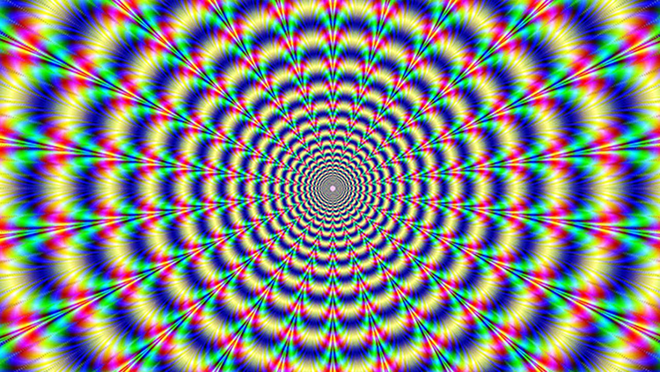
Hallucinogens
Drugs that alter perception (awareness of surrounding objects and conditions), thoughts, and feelings.
Cause hallucinations or sensations & images that seem real, though they are not.
Can be found in some plants and mushrooms or can be human-made.
Have been used for centuries for religious rituals.

Slide 20
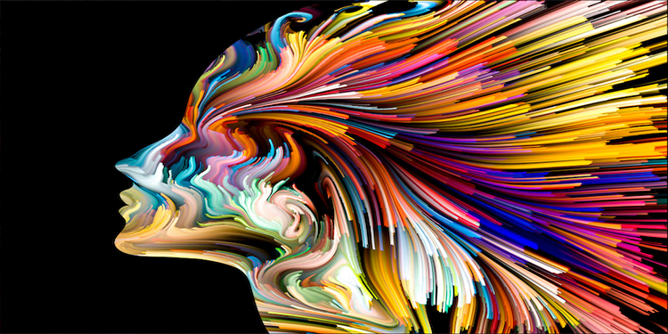
Hallucinogens
Examples:
LSD
Psilocybin
Peyote
DMT

Slide 21
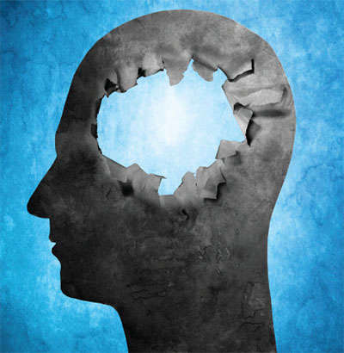
Dissociatives
Originally used as anesthesia during surgeries.
They work by interfering with the transmission of incoming sensory signals to the cerebral cortex and by disrupting the communication between parts of the CNS.
The term “dissociative” refers to the dissociation of brainstem functions from higher cortical areas, which are responsible for altering pain sensations and other stimuli during medical procedures.

Slide 22
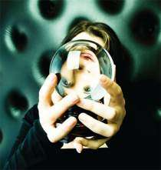
Dissociatives
Examples:
PCP
Ketamine
DXM

Slide 23

Opioids
Opioids are a class of drugs naturally found in the opium poppy plant.
Prescription opioids are used mostly to treat moderate to severe pain, though some opioids can be used to treat coughing and diarrhea.

Slide 24
Examples of Opioids
Prescription Opioids
  hydrocodone (Vicodin®) oxycodone (OxyContin®, Percocet®)
  oxymorphone (Opana®)
  morphine (Kadian®, Avinza®)
  codeine
Heroin
Fentanyl

Slide 25
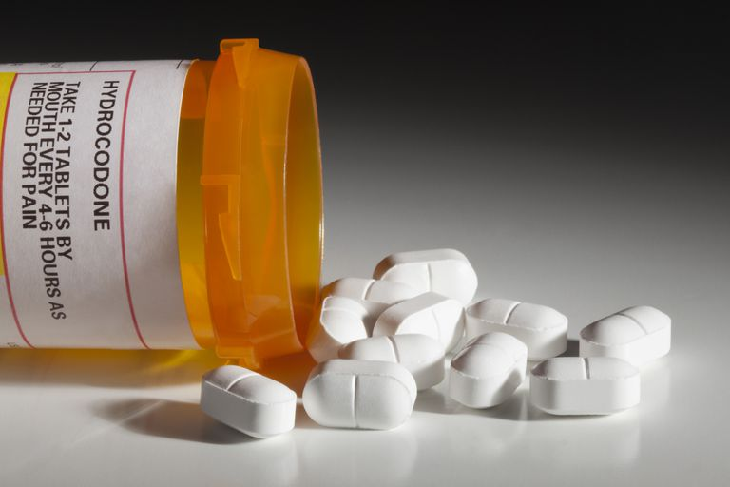
Prescription Opioids
Bind to and activate opioid receptors on cells located in many areas of the brain, spinal cord, and other organs in the body, especially those involved in feelings of pain and pleasure.
When opioids attach to these receptors, they block pain signals sent from the brain to the body and release large amounts of dopamine throughout the body.
This release can strongly reinforce the act of taking the drug, making the user want to repeat the experience.

Slide 26
Effects of Prescription Opioids
drowsiness
confusion
nausea
constipation
euphoria
slowed breathing
Can also cause hypoxia, a condition that results when too little oxygen reaches the brain. Hypoxia can have short- and long-term psychological and neurological effects, including coma, permanent brain damage, or death.

Slide 27
Inhalants
Inhalants are substances that produce chemical vapors that can be inhaled to induce a psychoactive, or mind-altering, effect.
Although other abused substances can be inhaled, the term "inhalants" is used to describe a variety of substances whose main common characteristic is that they are rarely, if ever, taken by any route other than inhalation.

Slide 28
Types of Inhalants
Volatile solvents
  Paint thinner
  Gasoline
  Felt tip markers
Aerosols
  Hairspray
  Spray paint
Gases
  Medical aesthetics
  Household products containing gases
Nitrites
  Room odorizer
  Leather cleaner

Slide 29
How Are Inhalants Used?
"sniffing" or "snorting" fumes from containers.
spraying aerosols directly into the nose or mouth.
"bagging" — sniffing or inhaling fumes from substances sprayed or deposited inside a plastic or paper bag.
"huffing" from an inhalant-soaked rag stuffed in the mouth.
inhaling from balloons filled with nitrous oxide.

Slide 30
Effects of Inhalants
Inhaled chemicals are absorbed rapidly into the bloodstream through the lungs and are quickly distributed to the brain and other organs.
Within seconds of inhalation, the user experiences intoxication along with other effects similar to those produced by alcohol.
Alcohol-like effects may include slurred speech; the inability to coordinate movements; euphoria; and dizziness.
In addition, users may experience lightheadedness, hallucinations, and delusions.

Slide 31

Cannabis (THC)
Marijuana refers to the dried leaves, flowers, stems, and seeds from the Cannabis sativa or Cannabis indica plant.
The plant contains the mind-altering chemical THC and other similar compounds.
Extracts can also be made from the cannabis plant.

Slide 32
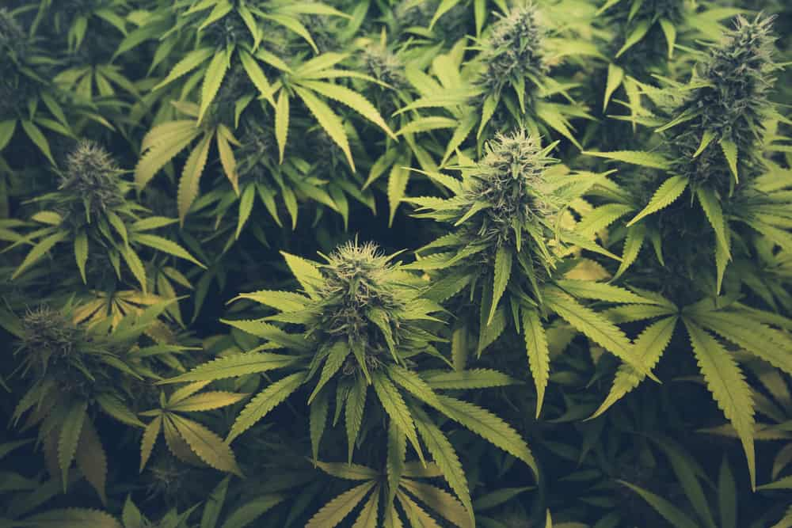
Ways People Use Cannabis
Joints (hand rolled cigarettes)
Bowl (small pipe)
Bong (water pipe)
Blunts (emptied cigars)
Vaporizers (avoid inhaling smoke)
Edibles (candy/cookies)
Dabbing (smoking THC resins [oil])

Slide 33
Effects of Cannabis
THC quickly passes from the lungs into the bloodstream.
The blood carries the chemical to the brain and other organs throughout the body.
The body absorbs THC more slowly when the person eats or drinks it.
They generally feel the effects after 30 minutes to 1 hour.
Marijuana overactivates parts of the brain that contain the highest number of these receptors.
This causes the "high" that people feel.

Slide 34
Other Effects
altered senses (seeing brighter colors)
altered sense of time
changes in mood
impaired body movement
difficulty with thinking and problem-solving
impaired memory
hallucinations (when taken in high doses)
delusions (when taken in high doses)
psychosis (when taken in high doses)

Slide 35
Long Term Effects
“Marijuana also affects brain development. When people begin using marijuana as teenagers, the drug may impair thinking, memory, and learning functions and affect how the brain builds connections between the areas necessary for these functions. Researchers are still studying how long marijuana's effects last and whether some changes may be permanent.”
https://www.drugabuse.gov/publications/drugfacts/marijuana

Slide 36
What does a drug user look like?
In groups of 3 answer the following questions on chart paper (will be shared with the class)
  What kind of people become drug addicts?
  What do they look like?
  How do they behave?

