Slide 1
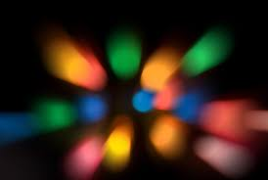
LIGHT
Lenses and Mirrors in Everyday life

Slide 2
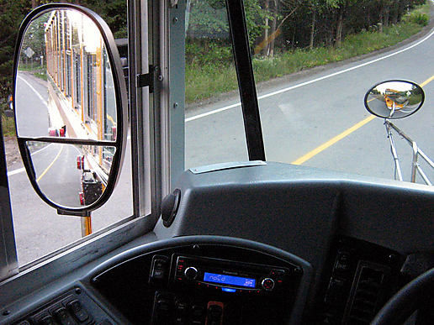
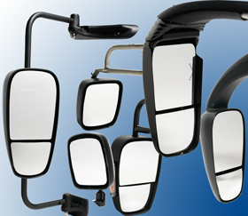
Lenses and Mirrors in Everyday life
Lenses and mirrors are part of our everyday life.

Slide 3
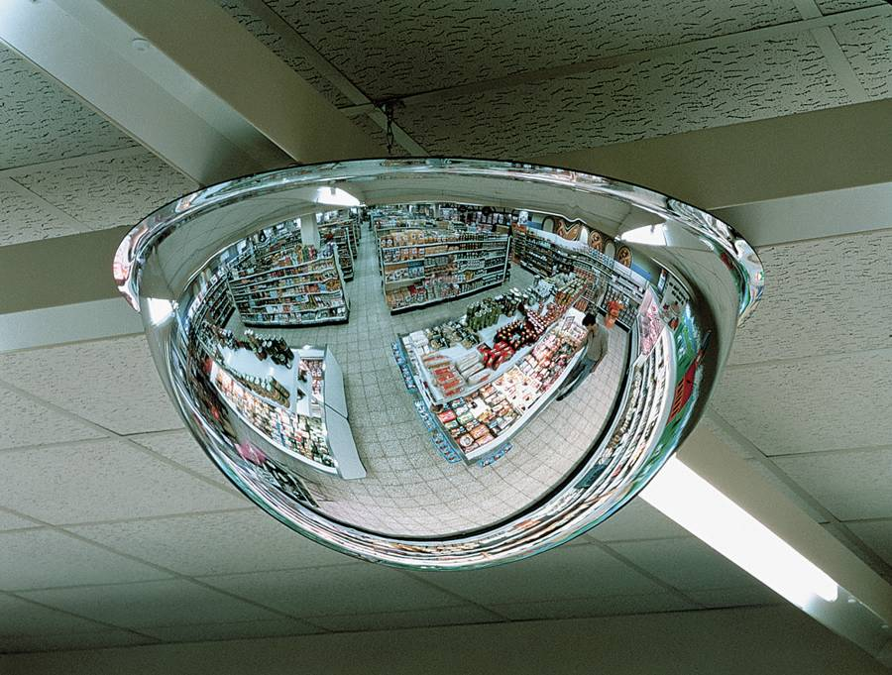
In department stores…

Slide 4
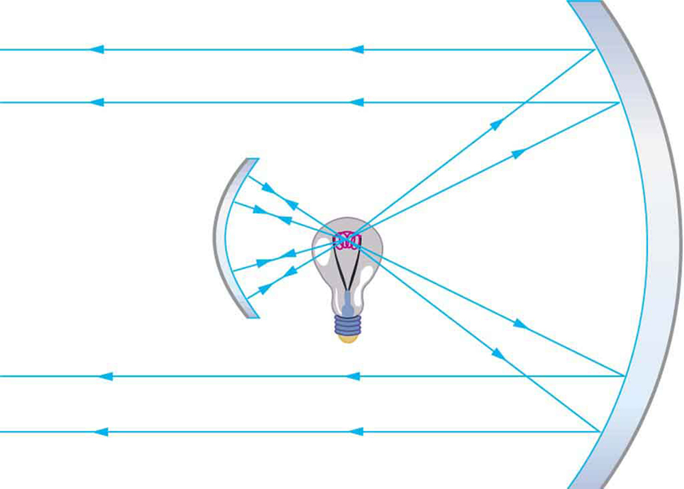
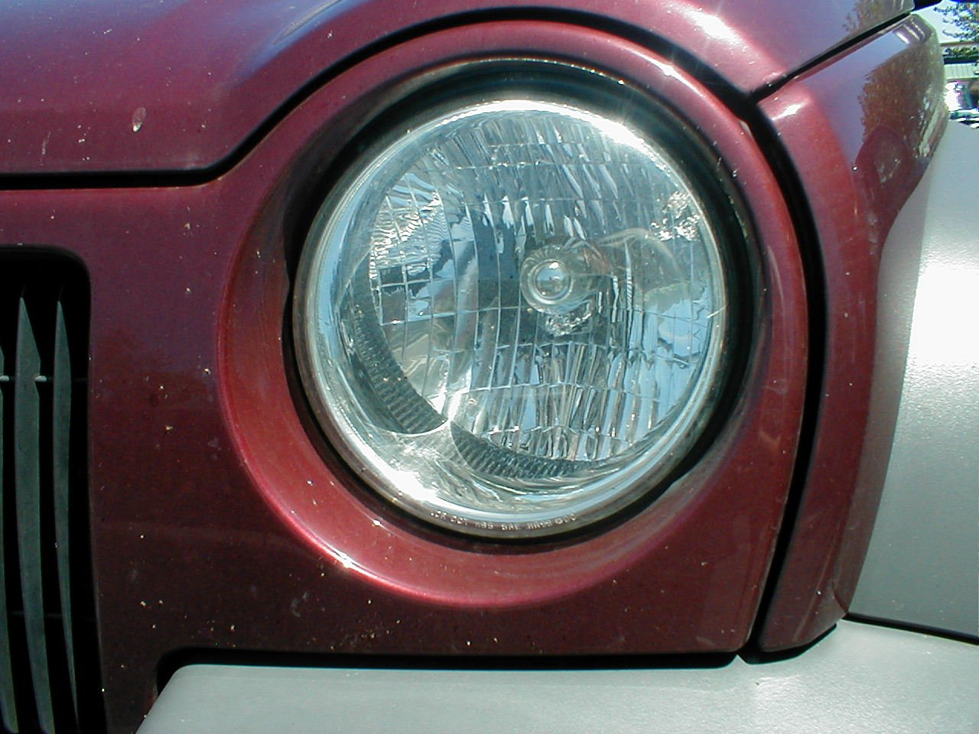
In our headlights…

Slide 5
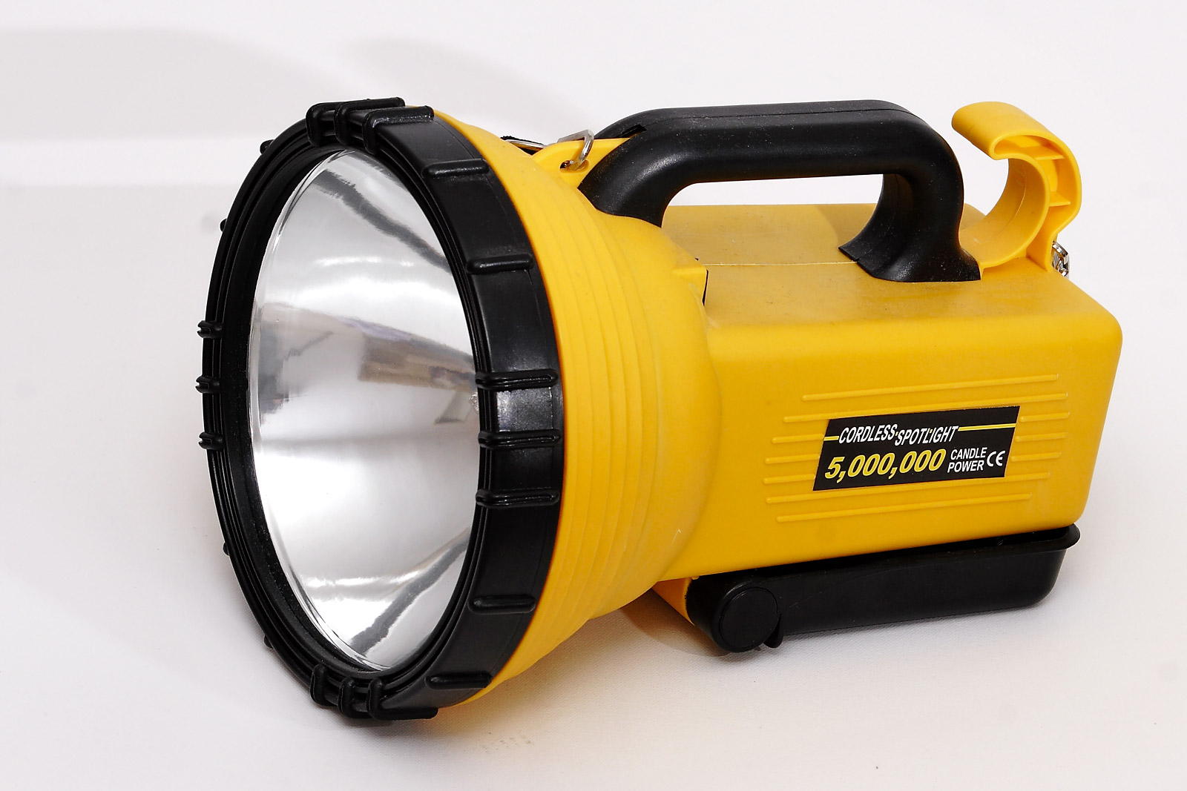
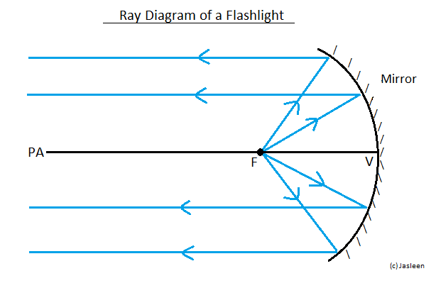
Our flashlights…

Slide 6
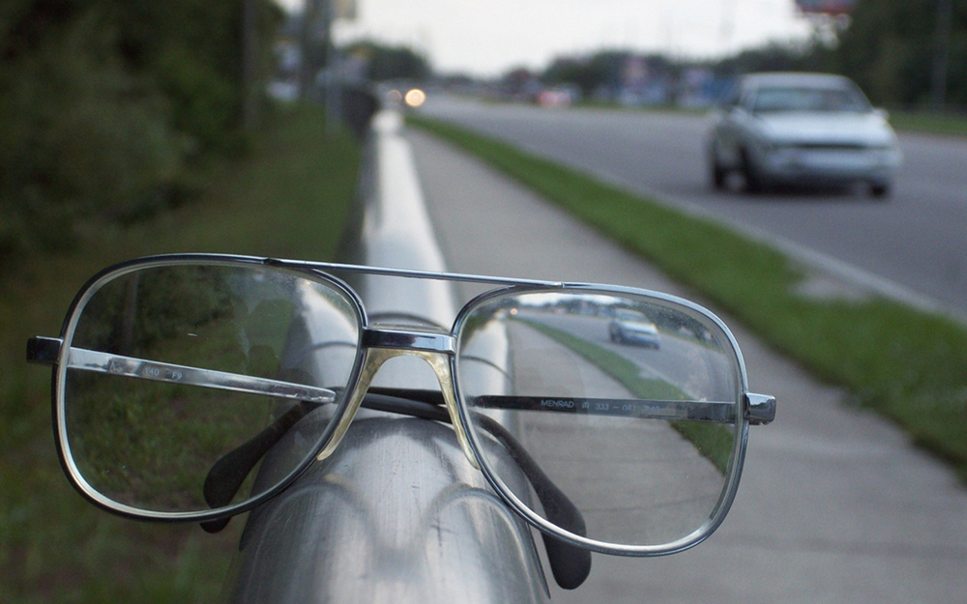
And in our eye glasses.

Slide 7
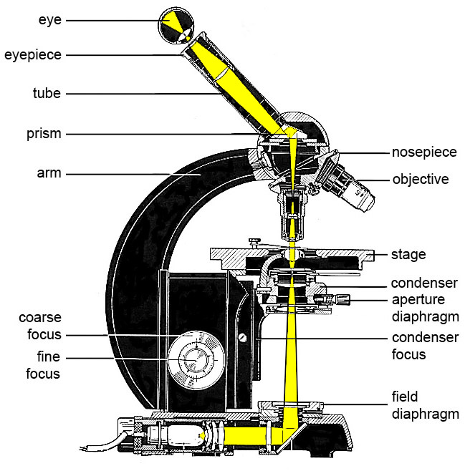
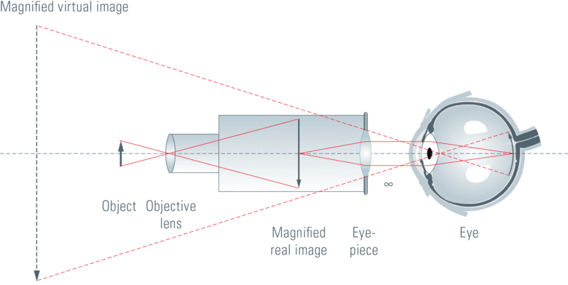
Microscopes

Slide 8
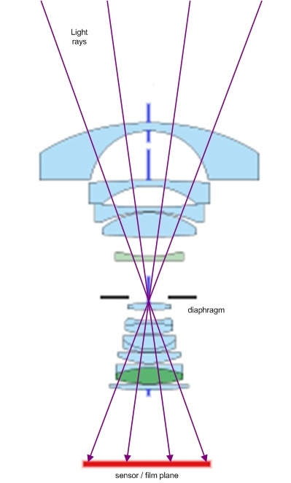
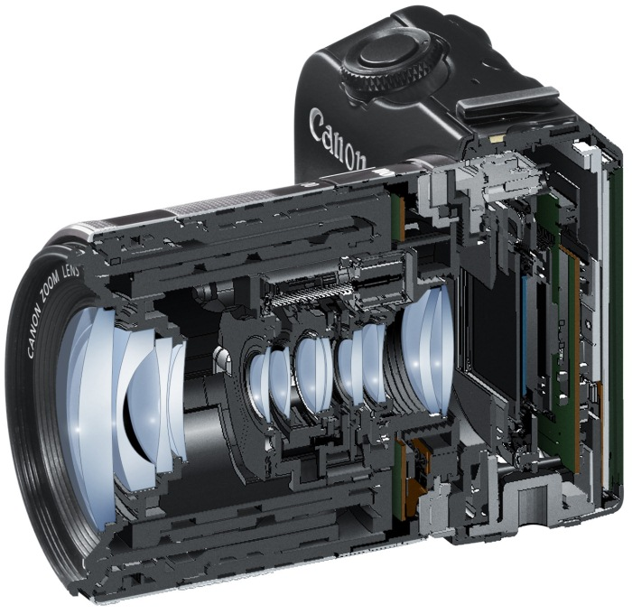
Cameras

Slide 9
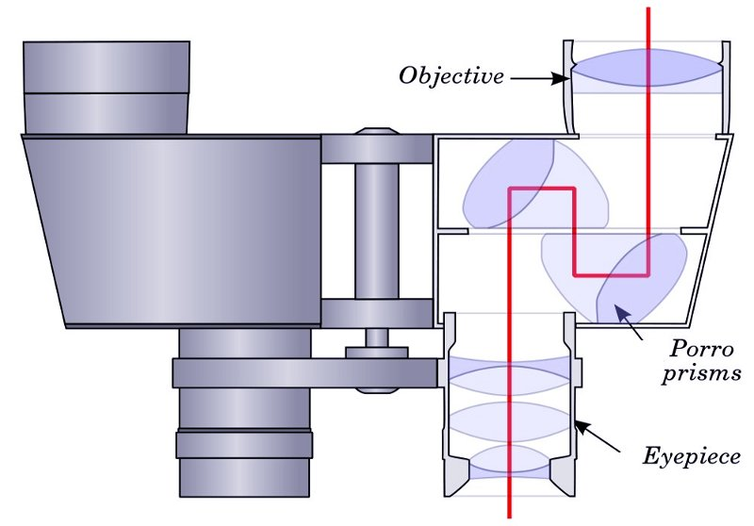
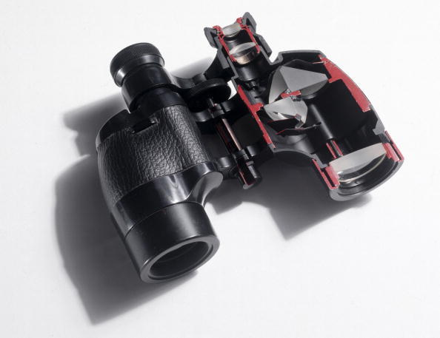
Even Binoculars

Slide 10
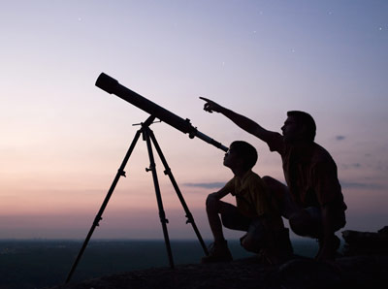
Finally in Telescopes

Slide 11
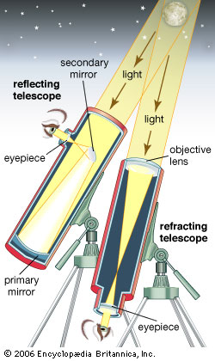
There are two main types of telescopes:

Slide 12
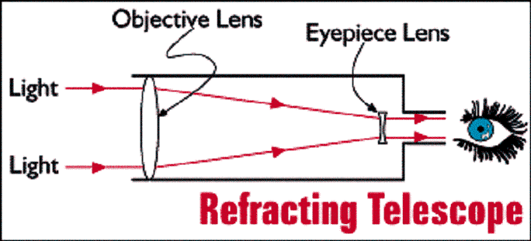
1. Refracting Telescopes
1. Refracting Telescopes – the first telescopes
Galileo and Kepler
The lenses used in these telescopes were difficult to make at the time.
Upright Image

Slide 13
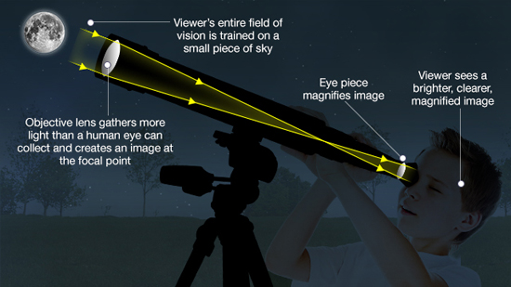
Animated telescope

Slide 14
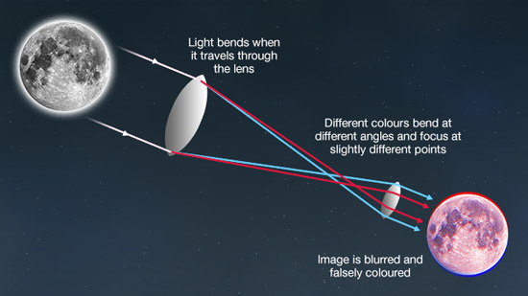
Problem with defracting telescope

Slide 15
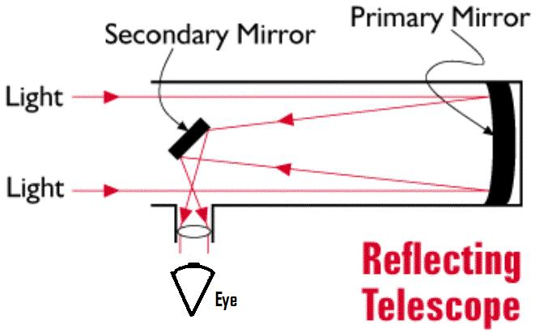
2. Reflecting Telescopes
Mirrors were much easier to make than lenses…and they didn’t refract the light and distort the colours.
Isaac Newton invented this kind of telescope.
Inverted image

Slide 16
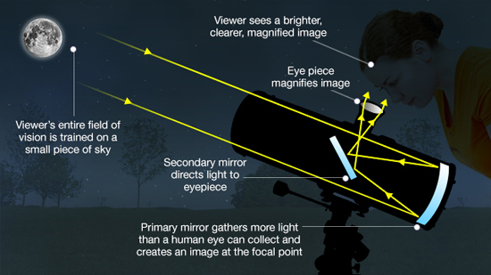

Slide 17
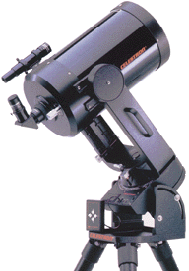
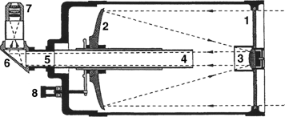

Slide 18
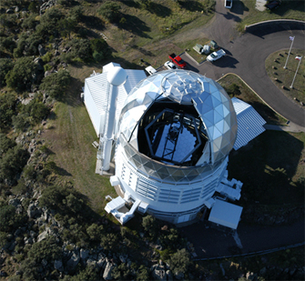
Another benefit of using mirrors instead of lenses is that big mirrors are easier and cheaper to make than big lenses.
Reflecting telescopes can be much much larger than refracting telescopes and therefore look deeper into space.

Slide 19
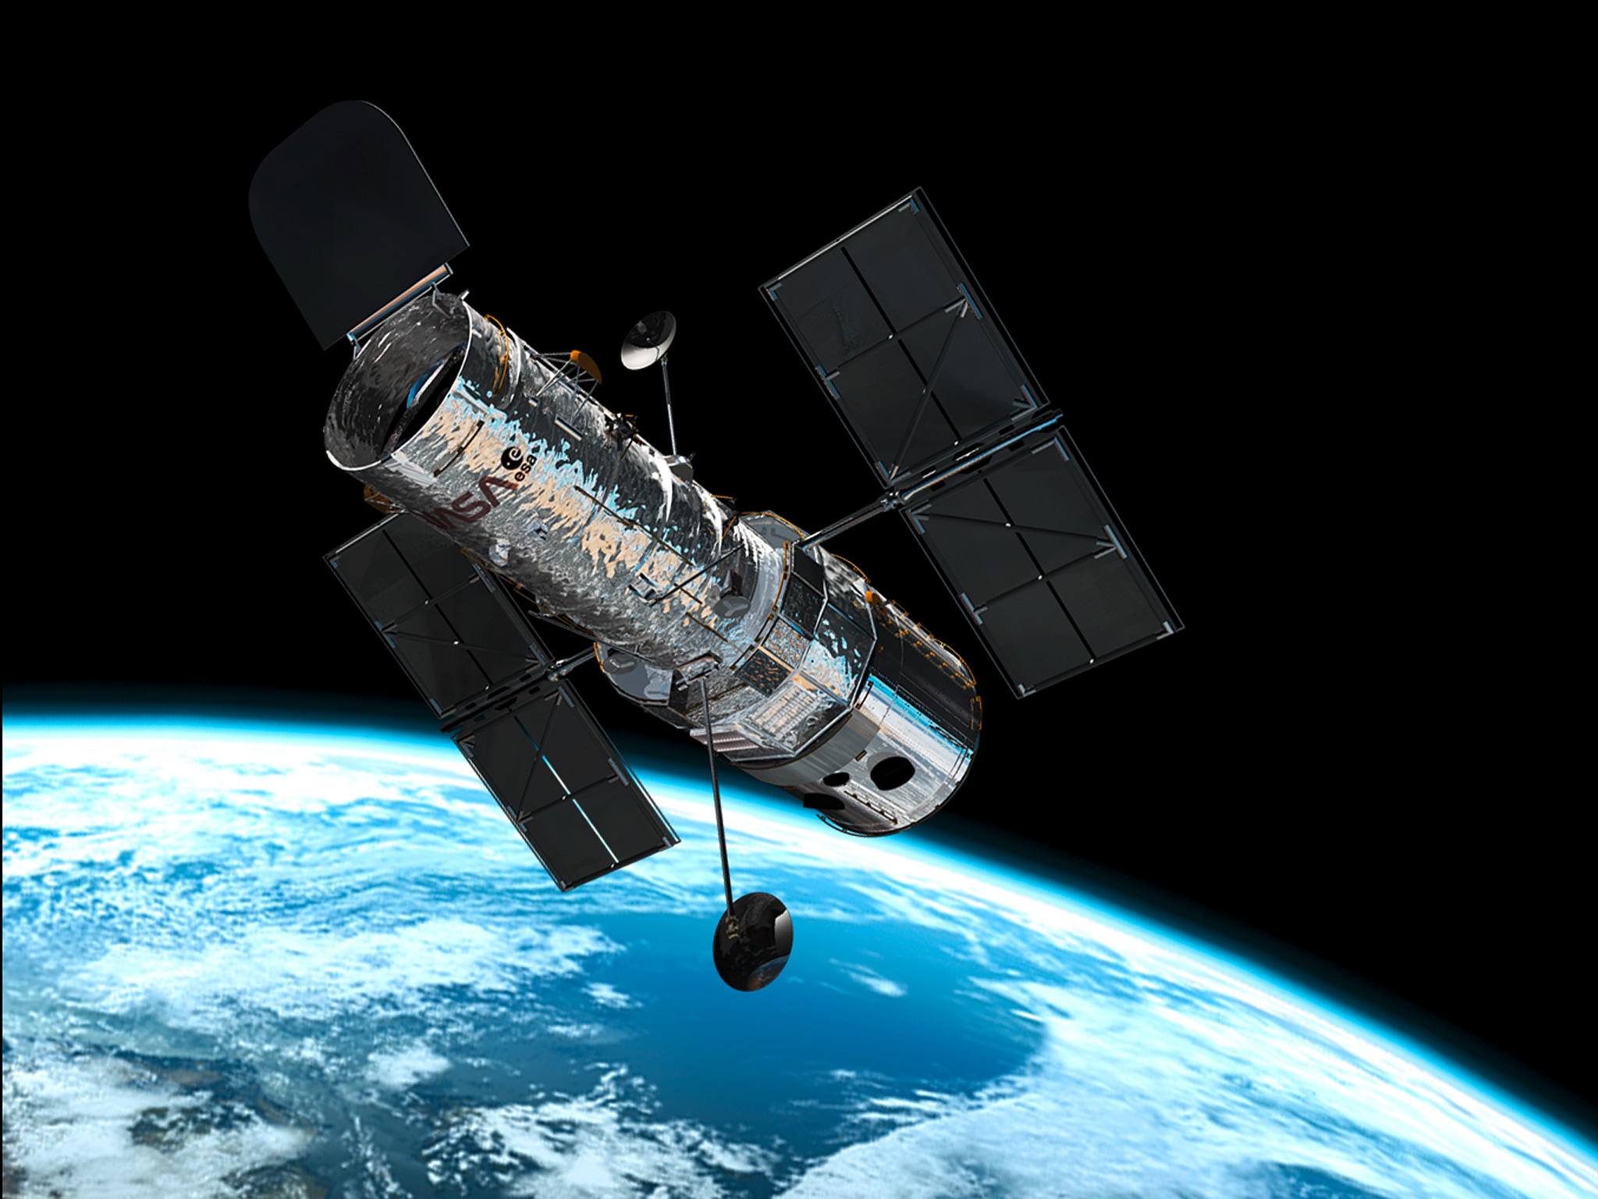
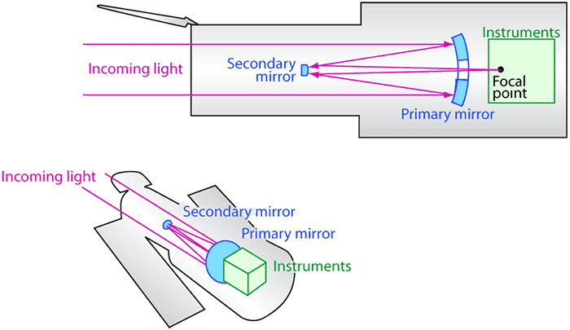
The Hubble Space Telescope is a reflecting telescope

Slide 20
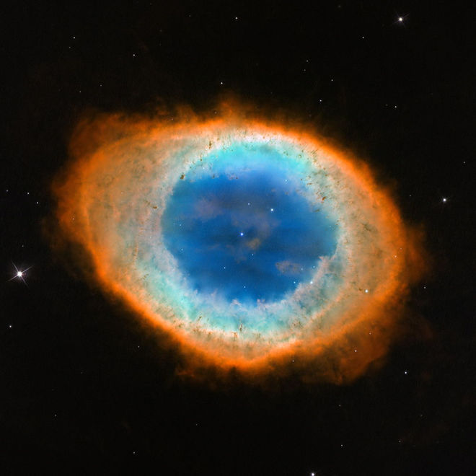
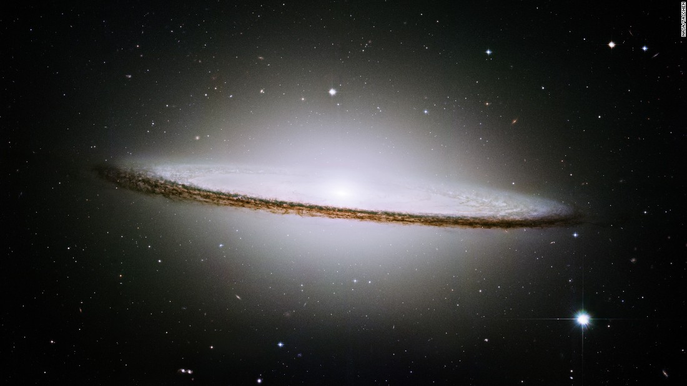
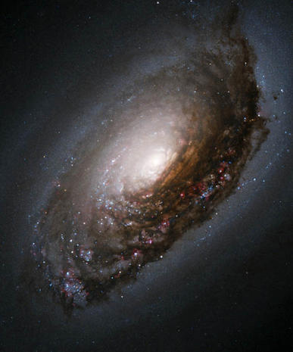
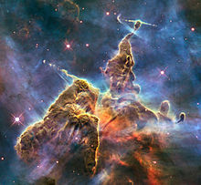
Hubble Deep Field video Part II

Slide 21
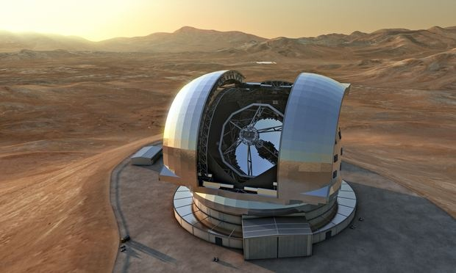
Largest telescope
European Extremely Large Telescope – 39 meter secondary mirror
Its primary mirror will be made of almost 800 segments – each 1.4 metres in diameter but only a few centimetres thick
This telescope will be big enough to spot signs of alien life on other planets!

Slide 22
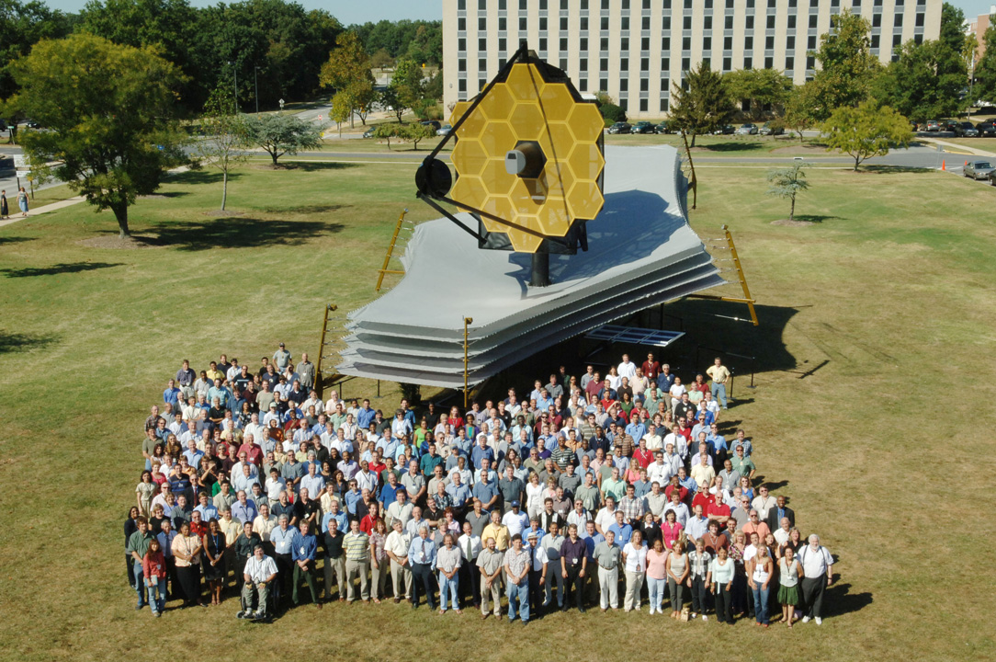
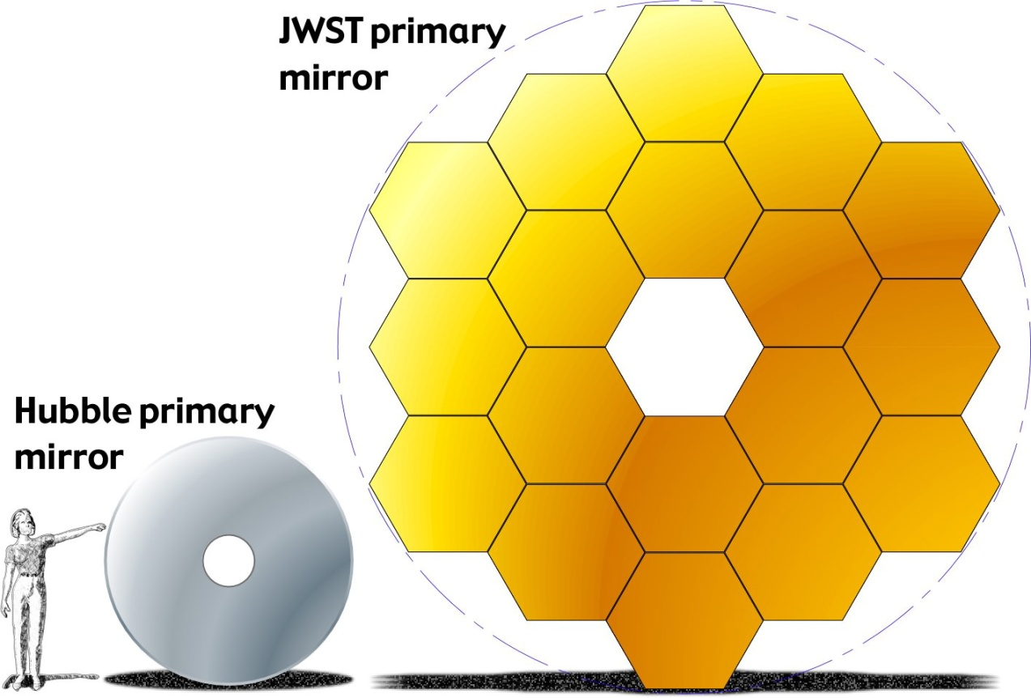
James Webb Space Telescope 2018

Slide 23
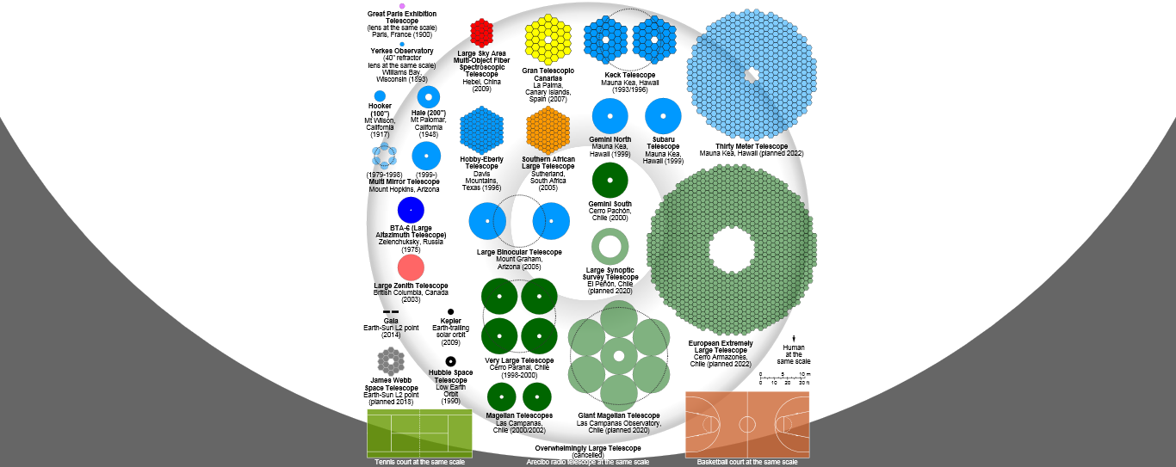
Link to picture

Slide 24
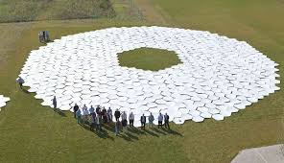

Slide 25
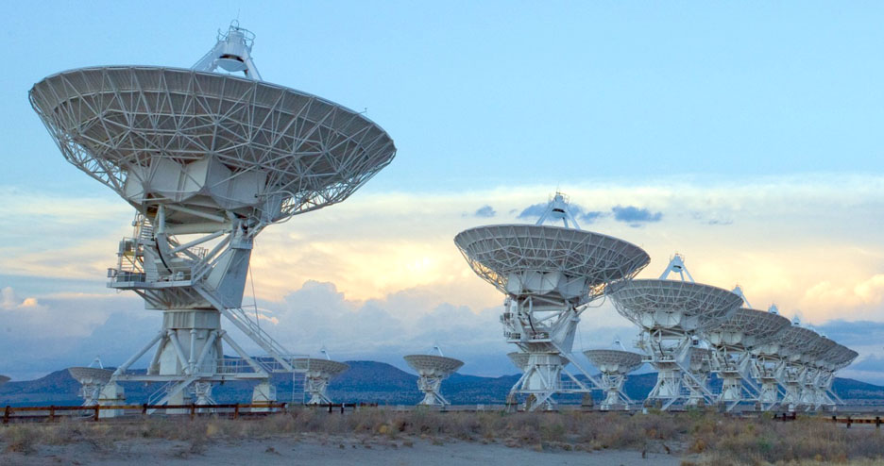
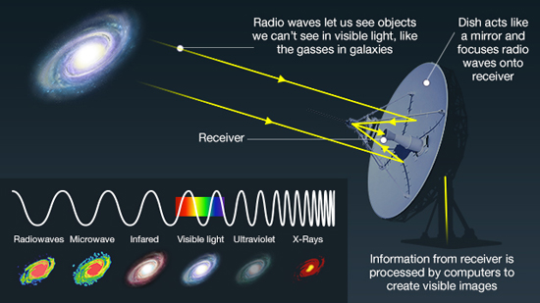
Radio Telescopes

