Slide 1
Healthy You- Healthy Eating
Lesson 2

Slide 2
Healthy Eating
What is healthy eating, and why is it important?

Slide 3
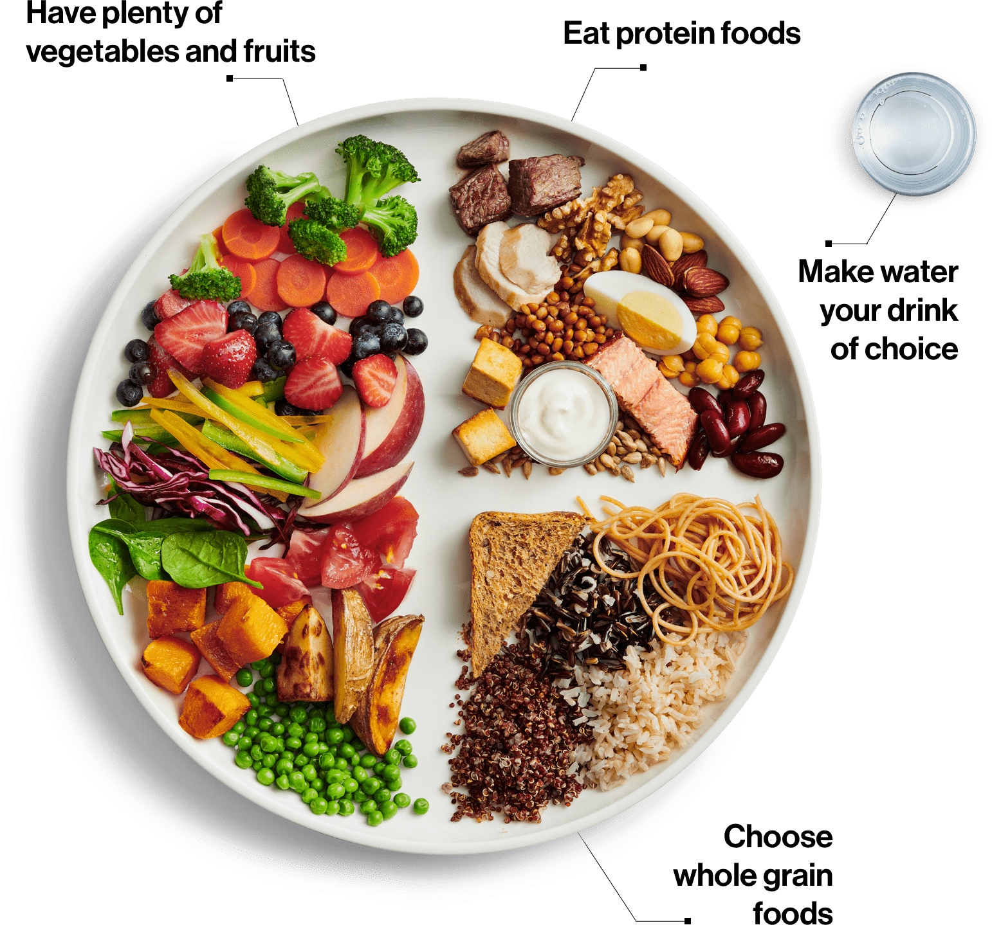
Canada’s Food Guide

Slide 4
Canada’s Food Guide
What are the benefits to following a healthy eating pattern?
Having enough energy to “fuel” activities
Meeting your body’s needs for vitamins, minerals and other nutrients
Strong muscles and bones
Contributes to overall health (physically, emotionally and mentally)
Reduce risk of illness and disease
Help reach/maintain good health and healthy weight

Slide 5
Canada’s Food Guide

Slide 6
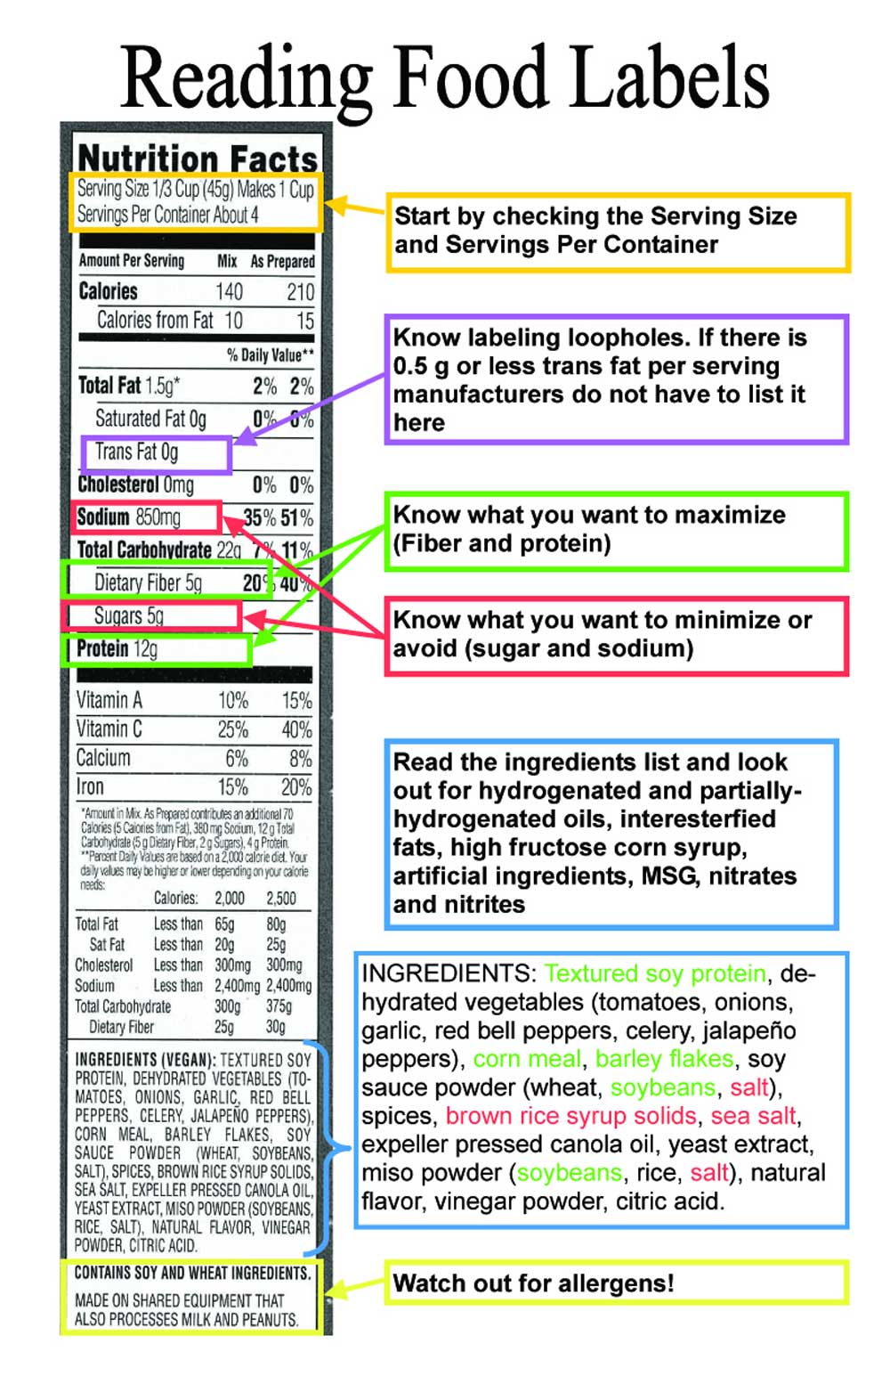
Snack Analysis

Slide 7
Snack Analysis
Compare the package size to the recommended portion
Is this the same or different?
Does it affect how much of that snack you would eat?
Get into groups of 3
On your group sheet record snacks of each member
Use the nutrition label on each of the snacks to complete the handout

Slide 8
Group Discussion
Which snacks did you consider the healthiest? Why?
Where did you get these snacks?
Do you ever choose snacks based on nutrition label information?
How often and when might you have a snack?

Slide 9
Self Assessment

Slide 10
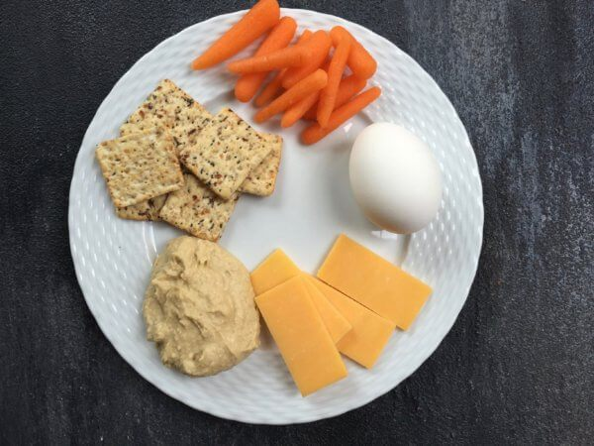
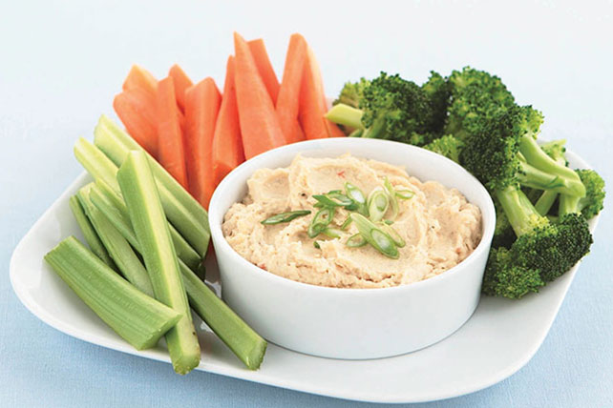
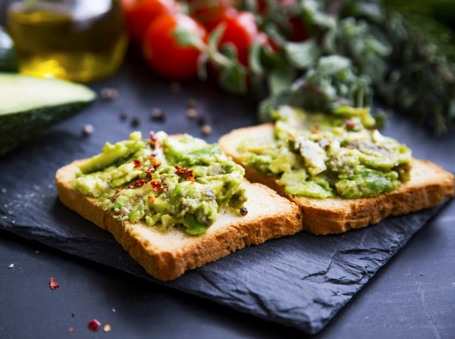
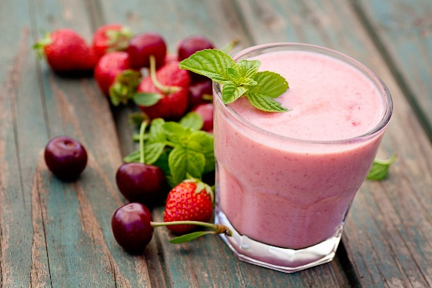
What is a Healthy Snack?
High in nutrients, and low in fat/sugar
Think of snacks as mini meals (keep sizes reasonable)
Should include 2 of 4 food groups
Take/plan snacks for on the go

Slide 11
When and How Much?
Depends on the person/day
Follow appetite and stop eating when you are full
Snacks are meant to tide you over until the next meal- not be a meal on its own
Should be limited to 3 times per day
Choose healthy snacks over junk most of the time
Try drinking water first to see if that curbs appetite

Slide 12
Healthy Eating Poster
You will create a poster which promotes your personal guidelines to healthy eating! Your poster should be creative enough to grab peoples’ attention plus demonstrate knowledge of healthy eating habits. Students will work individually.
Requirements:
Include several illustrations / photos / representations of your guidelines to health eating.
Include 3 specific recommendations / guidelines, with captions / descriptions. ( ie portion sizes, types of macronutrients to eat or to avoid, quality of foods recommended, sources of food to consume or avoid, proportions of macronutrients recommended etc.)
Give your healthy eating guidelines a creative / catchy title and slogan.
Posters must be a minimum size of 8.5 x 11.
How to create your healthy eating guidelines:
Step 1 – Consider the lessons regarding healthy nutrition that we discussed in class.
Step 2 – Think of a creative way to display your guidelines.
Step 3 – Make a rough sketch of your idea
Step 4 - Use an appropriate program (Google Docs/Slides) to create your poster. You may also choose to hand make your poster (draw or cut and paste)
Due Date: Monday October 7th

Slide 13
Poster Assignment
Use Canada’s food guide/how to read nutrition labels/snacking tips to help
Canada’s Food Guide Recommendations | Reading Food Labels | Healthy Snacking Tips
Have plenty of fruits and vegetables (1/2 your plate). | Look at serving sizes and compare to what you eat | Plan healthy snacks with at least 2 of 4 food groups.
Choose more plant based proteins. | Look at calorie information | Take snacks with you on the go.
Be mindful of your eating habits- eat with family and friends, enjoy your food. | Read the ingredient list and check to see if sugar is listed high on the list. Ingredients are listed based on proportions. | Keep Snack sizes reasonable.
Choose whole grain foods over white/bleached foods. | Check out the percent daily value to see if there is a little or a lot of a nutrient | Limit snacking to 3 times per day.
Make water your drink of choice. | Limit Fats, Cholesterol, Sodium
Cook more often with whole ingredients. | Choose snacks high in fibre, vitamin A/C, Iron, Calcium, Protein
Limit high processed foods.

