Slide 1
Viscosity Conclusions

Slide 2
Why Are Fluids Viscous?
We know from our knowledge of the states of matter that both liquids and gases have particles that can move passed one another
The ability to do this gives them the ability to FLOW (MAKING THEM A FLUID)
Viscosity arises from the fact that as these particles move past one another, they RUB against each other or BUMP into one another
The rubbing of the particles creates FRICTION
The friction is what SLOWS down the particles
We call this “INTERNAL FRICTION”
The higher the internal friction, the HIGHER the viscosity.
The particles of the fluid will also have friction against the material over which they are flowing.
This is called EXTERNAL friction, and also causes a change in flow rate

Slide 3
Can Solids Be Viscous?
Viscosity is a property of fluids, it is related to how well a fluid can flow.
Earlier in the unit we sad that a fluid is a liquid or a gas, which would mean that a solid cannot be viscous because it is not a fluid.
A fluid was any substance that can flow, or that can be poured
So why is it that a solid is not a fluid? Can you not pour your cereal into a bowl?
We say we pour our milk in our cereal. We also saw we pour our cereal in a bowl.
So what is the difference? Why is a cereal not considered a fluid?

Slide 4
Why Does Viscosity Differ?
As discussed, viscosity is a result of PARTICLE FLOW and INTERNAL FRICTION. As we know, not all particles are the same.
Pictured below are a water molecule and a fructose molecule (corn syrup is a combination of fructose, glucose and water)
Looking at these molecules, can you see why the two substances would have different levels of viscosity?
The internal friction caused by the LARGE BULKY SHAPE of fructose molecules is much higher than the internal friction caused by the SMALL COMPACT SHAPE of the water molecules
Gases have much LARGER SPACES so regardless of MOLECULE SHAPE there is more room to allow fluids to flow. This means LESS FRICTION.

Slide 5
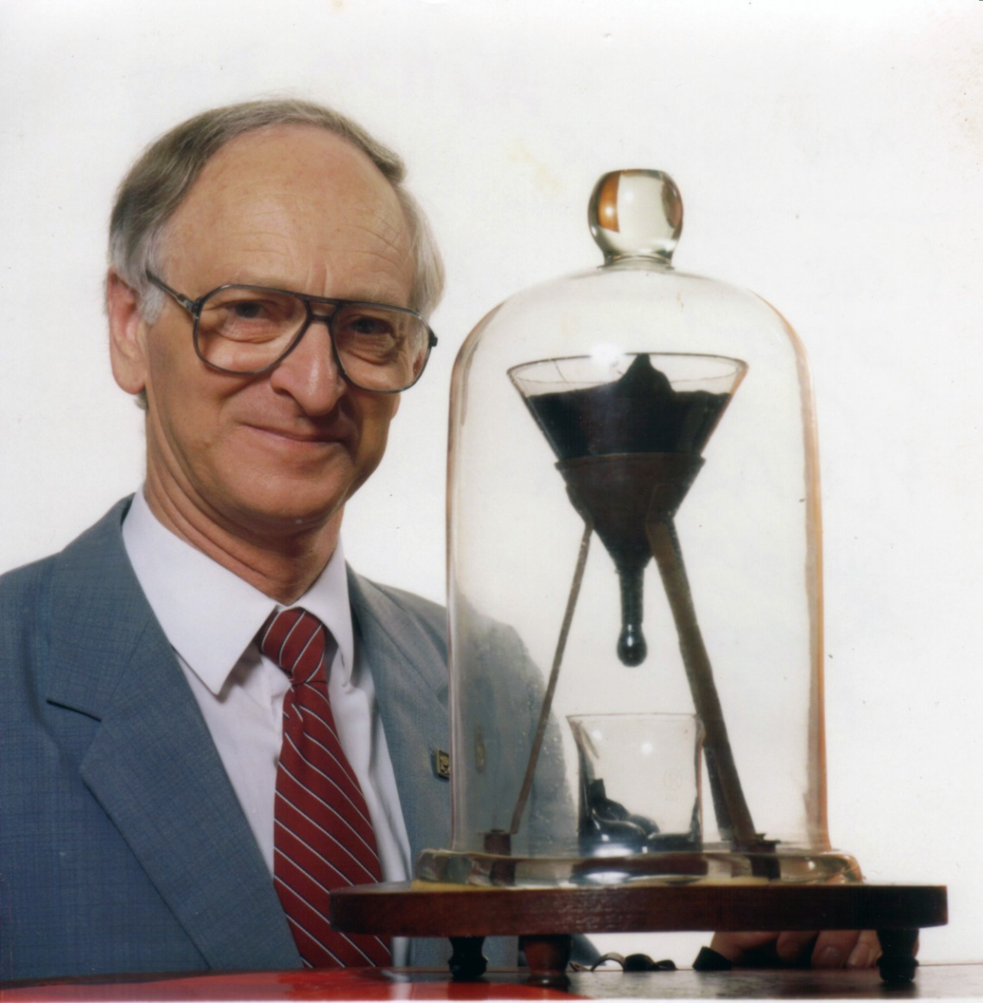
Most Viscous “Fluid” Ever
The eighth drop fell on 28 November 2000, allowing experimenters to calculate that the pitch has a viscosity approximately 230 billion (2.3×10¹¹) times that of water.^{[3]}
http://www.thetenthwatch.com/
https://youtu.be/ybdLQeHvNjQ

Slide 6
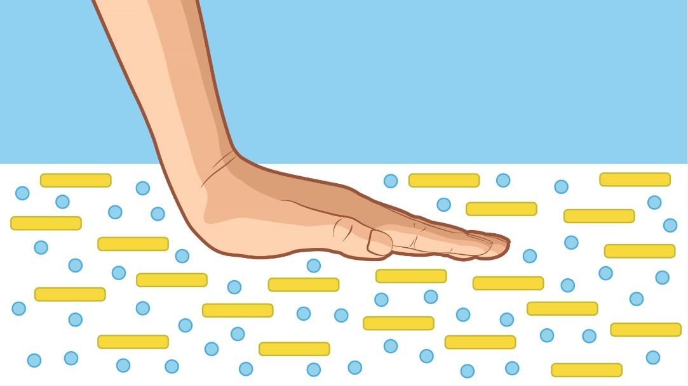
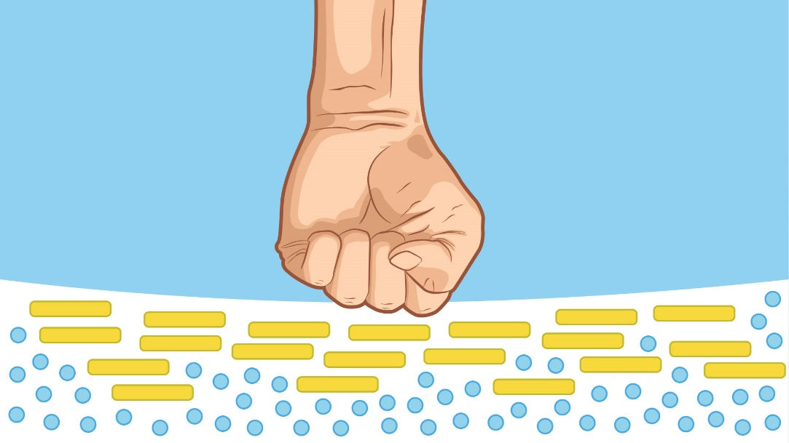
Non- Newtonian Fluids
Ex: Oobleck
Applying pressure to the mixture increases its viscosity (thickness). A quick tap on the surface of Oobleck will make it feel hard, because it forces the cornstarch particles together. But dip your hand slowly into the mix, and see what happens—your fingers slide in as easily as through water. Moving slowly gives the cornstarch particles time to move out of the way.

Slide 7
Entry Slip
Determine why someone working quality control at a Heinz ketchup factory would need to concern themselves with viscosity.
Write a brief paragraph on the cue card provided and hand in to pass in bin.

