Slide 1
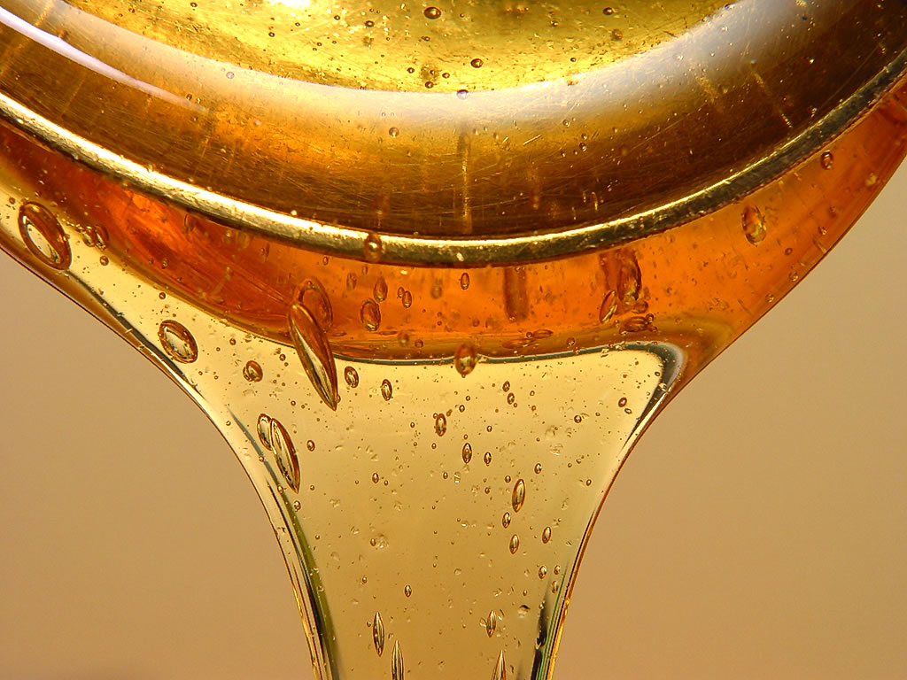
Viscosity & Fluids
What is viscosity
What affects viscosity
Flow Rate

Slide 2
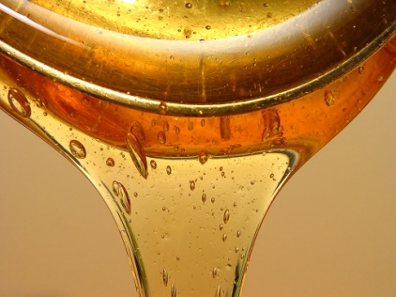
The Big Idea!!!
Viscosity is the term we use to describe the “Thickness” or “Thinness” of a fluid and how well it flows
Fluids that have a High Viscosity are said to be very “thick” and do not flow easily
Examples would be: Honey, Molasses, Tar
Fluids that have a Low Viscosity are said to be thinner and flow more easily
Examples would be: Water, Pop, Juice

Slide 3
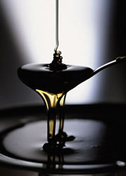
What is Viscosity?
Viscosity is a property of all fluids because it deals with the way the particles “flow” around one another… it is the thickness of the fluid
Both gases and liquids have some degree of viscosity, however, it is easier to comprehend viscosity in liquids because we can see and feel the “thickness” of a fluid

Slide 4
What is Viscosity?
Viscosity of a fluid is a product of the attractive forces between the particles that make up the fluid
Fluids that have particles that are strongly attracted to each other do not flow as easily
In contrast, fluids whose particles are not as strongly attracted to each other flow much more easily

Slide 5
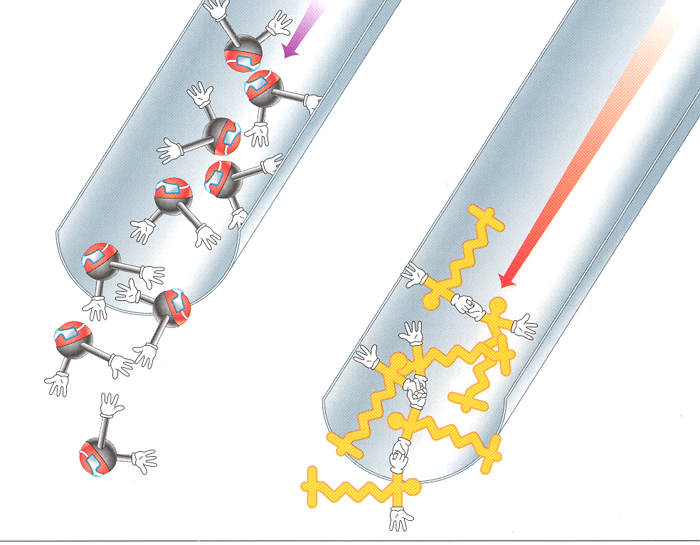
What is Viscosity?
Water
Syrup
Loosely Attracted Strongly Attracted
Particles Particles
These particles are not These particles are more strongly strongly attracted so attracted to each other so they they flow more easily do not flow as easily

Slide 6
What is Viscosity?
Viscosity is the term we use to describe the “Thickness” or “Thinness” of a fluid and how well it flows
Fluids that have a High Viscosity are said to be very “thick” and do not flow easily
Examples would be: Honey, Molasses, Tar
Fluids that have a Low Viscosity are said to be thinner and flow more easily
Examples would be: Water, Pop, Juice

Slide 7
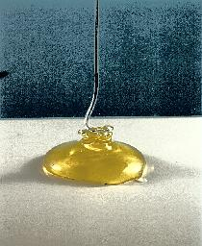
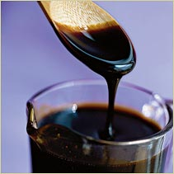
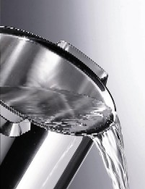
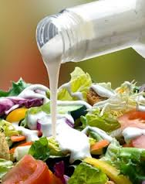
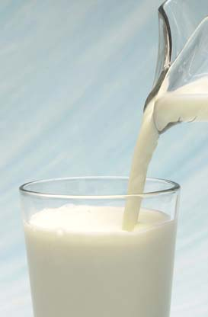
Practice Classifying
Please list these fluids in order from the most viscous to the least viscous:
Salad Dressing
Molasses
Water
Syrup
Cream

Slide 8
Practice Classifying
Please list these fluids in order from the most viscous to the least viscous:
Molasses → Syrup → Dressing → Cream → Water

Slide 9
Flow Rate
Flow rate is the speed at which fluids can flow
Highly viscous (thick) fluids have a very slow flow rate
Less viscous (thin) fluids have a very fast flow rate

Slide 10
Factors Affecting Viscosity
Temperature has the only major affect on viscosity in fluids
Viscosity between gasses and liquids react oppositely to changes in temperature

Slide 11
Temp & Liquids
If we increase the temperature of a LIQUID we excite the particles within the liquid causing them to flow more easily
Increasing temp. causes friction between the particles of a liquid to decrease
THEREFORE
The viscosity of a liquid decreases as it is heated, and increases as it is cooled

Slide 12
Temp & Gasses
If we increase the temperature of a GAS we excite the particles within the gas causing them to move faster and collide more often
The more collisions between particles has the opposite effect… its actually increasing friction between the particles and slows the flow rate
THEREFORE
The viscosity of a gas increases as it is heated, and decreases as it is cooled

Slide 13
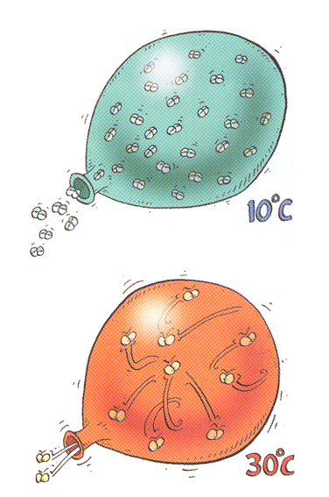
Factors Affecting Viscosity

Slide 14
Your Assignment
Your assignment for the rest of the class is to complete the worksheet you are being given right now. We will review this sheet in the next class so it is to be completed for homework
Use pages 40 - 49 in the Science Focus 8 Textbook to help you complete the worksheet.
Use pages 39 - 41 in the Science in Action 8 Textbook to help you complete the worksheet.

