Slide 1
Body Systems Activities

Slide 2
Circulatory System
Function: Transports materials to and from cells (oxygen, nutrients, wastes)
Organs: Heart, Veins, Arteries, Capillaries, Blood
Interactions:
Respiratory: Deliver O2 from lungs to cells and drop off CO2 from cells to lungs
Digestive: Absorbs and delivers digested nutrients to cells
Excretory: kidneys filter cellular waste out of blood for removal
Immune: transports WBCs throughout body
Nervous: Brain controls heartbeat
Endocrine: transports hormones

Slide 3
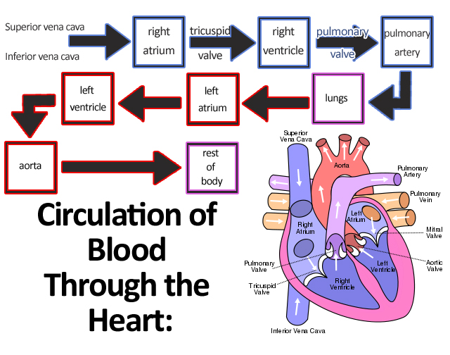
Flow of blood through the Heart

Slide 4
Activity: Flow of Blood through the heart
1 volunteer to be the blood
Everyone else gets an organ

Slide 5
Components of Blood
Plasma: Liquid that contains all other blood products (including electrolytes and salts)
Red blood Cells: red due to hemoglobin
White Blood Cells: Part of immune system
Platelets: used for clotting (patches wounds)

Slide 6
Activity 2: are you alive?
Part 1: Find your pulse: neck or wrist (count number of beats in 10 seconds and then multiply by 6
Part 2: Jumping Jacks or run in place for 1 minute and find pulse again
Question: Why does your heart rate increase?

Slide 7
Activity 3: How is it all connected?
Groups of 4-5
Get chromebook, CO2 sensor (straw and plastic bag), Temperature Sensor
Start chromebook and open SparkVue app
Turn on sensors and connect using Bluetooth
Pick graph only
Select 1 Volunteer to collect data from
Run 1: put temperature probe on forehead; breathe one normal breath into the baggie (with CO2 sensor inside) through the straw (remove straw and seal off when finished); allow chart to generate data
Run 2: do 30 seconds of jumping jacks while holding breath; then collect data as above (temperature probe on forehead; single breath into straw and seal baggie with CO2 sensor)
Questions:
what do you notice about the temperature of your body and the CO2 levels?
Why do you think this is happening?
What body systems are connected and working together to do this?

Slide 8
Respiratory System
Function: Takes in oxygen and removes carbon dioxide and water
Parts: Nose, Trachea, Bronchi, Bronchioles, Alveoli, Lungs
Interactions:
Circulatory: Takes in O2 for delivery to cells and removes CO2 brought from cells
Excretory: Removes gaseous wastes
Nervous System: Controls breathing
Muscular: Diaphragm controls breathing

Slide 9
Activity 4: Full of Hot Air
1 volunteer: How much air do your lungs hold?
WITH 1 BREATH, blow up the balloon as large as you can
Find circumference
Volume=4/3∏r³

Slide 10
Exit Slip
Answer the following 3 questions on a sheet of looseleaf and hand in to bin before leaving class:
What happens to blood as it moves through the circulatory system?
What happens to your heart rate when you exercise? Why?
What other systems are connected to the circulatory system and how do you know?
How does the diaphragm work to pull air into the lungs?

