Slide 1
Bell let’s Talk Day
January 29th, 2020

Slide 2
Mental Health vs Mental Illness
The World Health Organization (WHO) defines mental health as:
“a state of well-being in which every individual realizes his or her own potential, can cope with the normal stresses of life, can work productively and fruitfully, and is able to make a contribution to her or his community.”
Mental illness is defined by Health Canada as a range of illnesses that:
“are characterized by alterations in thinking, mood or behaviour associated with significant distress and impaired functioning.”
One in five Canadians have a diagnosed mental illness.

Slide 3
The continuum model of Mental Health

Slide 4
What is Mental Health?
https://www.youtube.com/watch?v=v41rcUysB10&feature=youtu.be
https://www.youtube.com/watch?v=KIswi_4yRaE

Slide 5
The Stigma!
https://letstalk.bell.ca/en/our-initiatives/team/emma-o-hare
Emma first showed symptoms of depression when she was eight years old. Ever vigilant, her parents took the necessary steps to get her help. As the years went by, Emma felt increasingly different from others. She did not share their interest in sports, school or having fun with friends, seeing these things as a chore. Although she was undergoing therapy, Emma wasn’t seeing meaningful results and she did not feel she was getting any better. Something still wasn’t right. At age 12, she finally wrote a long letter to her parents—a heartfelt plea. She told them frankly about her deepest feelings, described the hopelessness and shared her inability to see past her illness. Being this honest with her parents and with herself was Emma’s first major step toward recovering her mental health.
Aware of mental health issues, Emma’s parents made it clear to her that she should not feel any shame about her own situation. With their love and support, she is finally able to look toward the future. When she started high school, she decided to gradually share her story. Emma hopes that talking openly about her depression will help her peers be more open-minded when it comes to mental health issues. Eventually, she also hopes to help young people find the courage to talk, so that they don’t suffer in silence. However, the education process can take some time before it produces the desired results. People have contacted Emma years later to talk about their mental illness and to ask for advice. Emma tells them to not give up hope, and to celebrate small victories that lead to resilience.

Slide 6
Think about it:
What do you think Emma is saying in her message?
How did Emma realize that she had a problem?
What did she do to help herself?
What do you think Emma means when she refers to “having the courage to talk”?
Do you believe that talking to someone when we are feeling lonely, upset, depressed or anxious makes a difference?

Slide 7
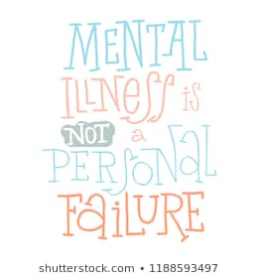
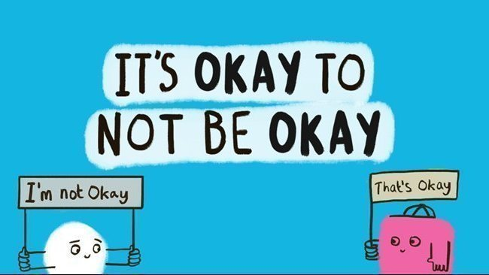
Assignment
You will be required to create a poster that promotes Mental Health and #BellLetsTalk day around the school
You can choose to address any point of Mental Health/Illness/Stigma/Promoting the cause
These posters will be placed around the school to promote participation/talk/understanding of Mental Health and Illness

