Slide 1
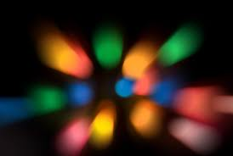
LIGHT
The 6 principles of Light

Slide 2
1. Light is a form of energy

Slide 3
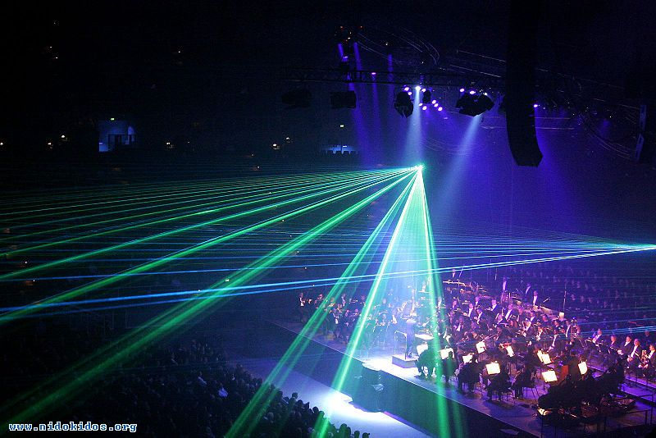
The 6 principles of Light
2. travels in a straight line

Slide 4
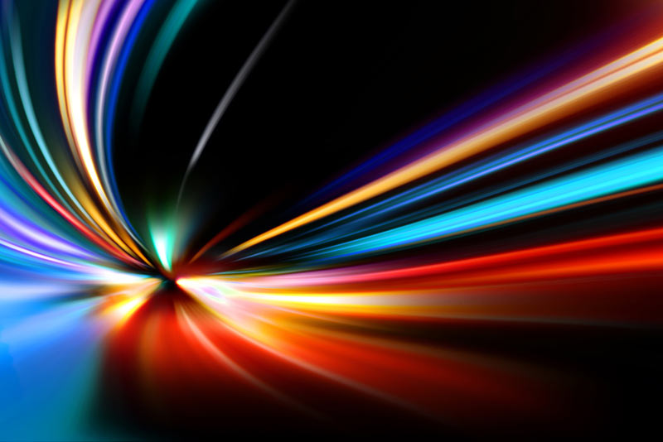
3. Light travels in a vacuum (empty space) at 300,000 km/sec (and in some types of media at slower speeds.)

Slide 5
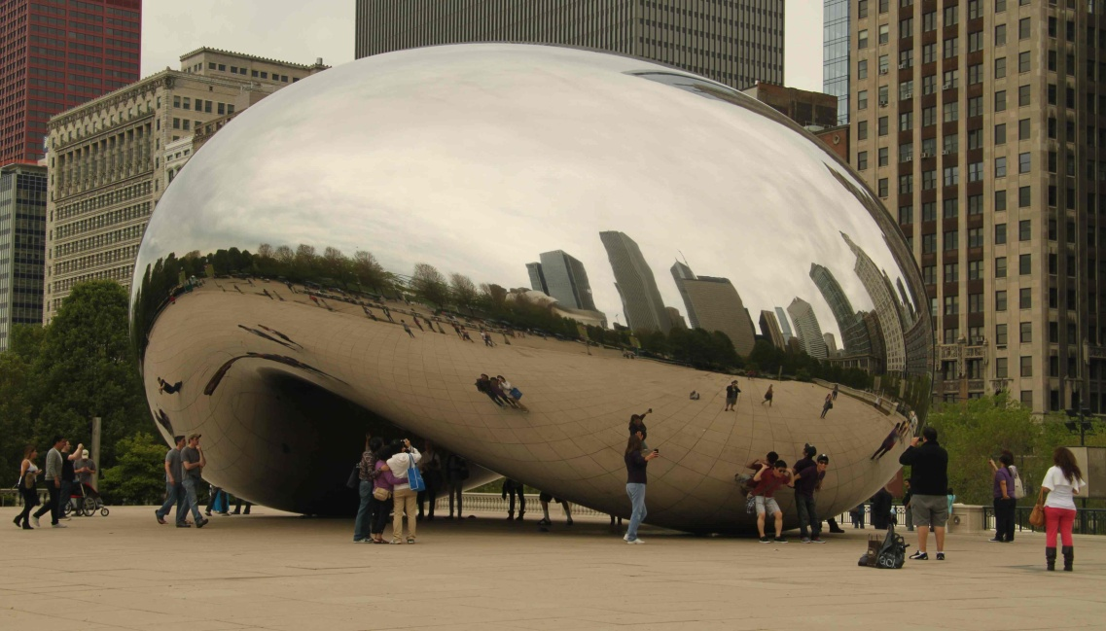
4. Reflection – light reflects off objects (which makes them visible).
The angle of incidence is always equal to the angle of reflection

Slide 6
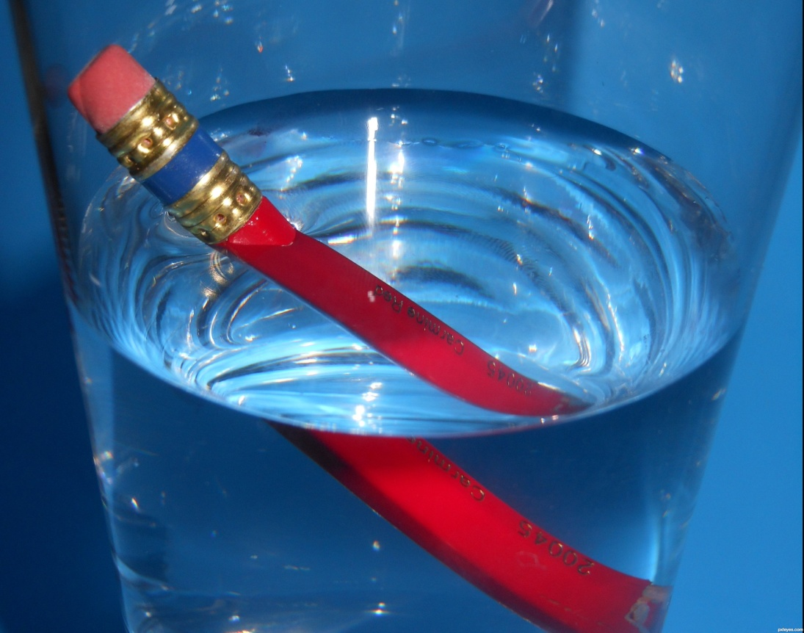
5. Refraction is the bending of a wave when it enters a medium where its speed is different.
The Law of Refraction

Slide 7
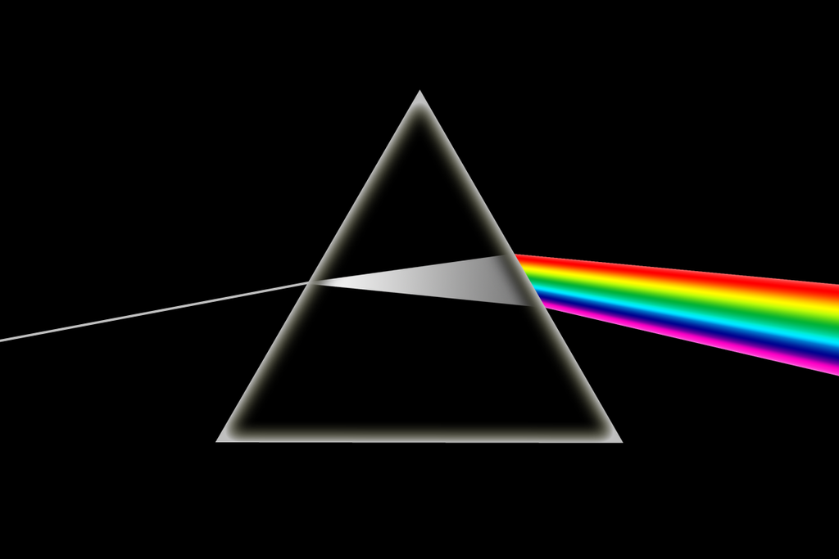
6. Dispersion – each of the colours that make up white light refract differently and so spread apart and become visible when passing through a denser medium.
Go to the dark room and use prism and chalk dust

Slide 8
Hand out prisms and flash lights and diffraction gratings and spectroscopes
See who can make a rainbow spectrum first and best
Then look through the gratings and scope

Slide 9
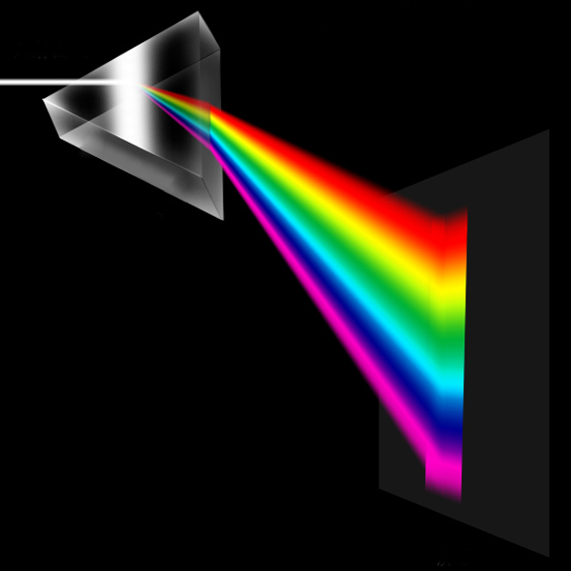
Sir Isaac Newton discovered that dispersion happens when white light refracts through a prism. (ROYGBIV)

Slide 10
